Slide 1

kubernetes
BY TASHIK MOIN MICROSOFT GOLD AMBASSADOR | MCT | MCP | MCSA

Slide 2
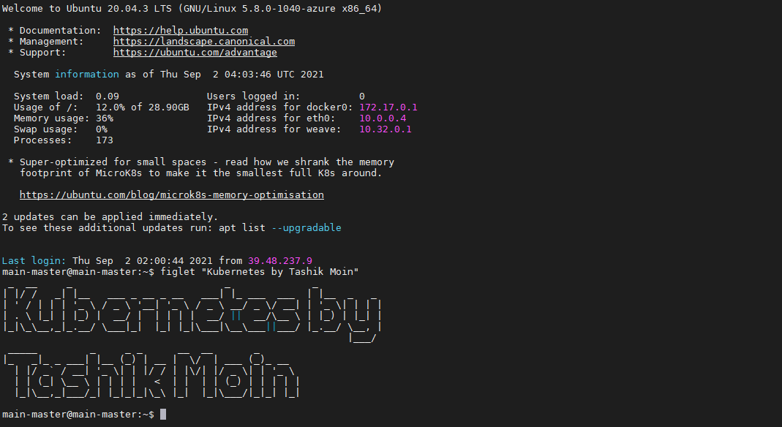

Slide 3
Monolith architecture
Tightly coupled applications.
The entire application is build together to serve as a single unit for production environment which cause down time for the application because if we modify or update one feature then we will have to build the entire application again.
Implementing/Updating one feature can break other features of our application.
Code is not organized.
As the user increases, we make new monolith instances to handle the load.
We have single UI, single Business logic and single Database layers UI → Business Logic → Database.
If one thing fails, the entire application is rebuild.

Slide 4
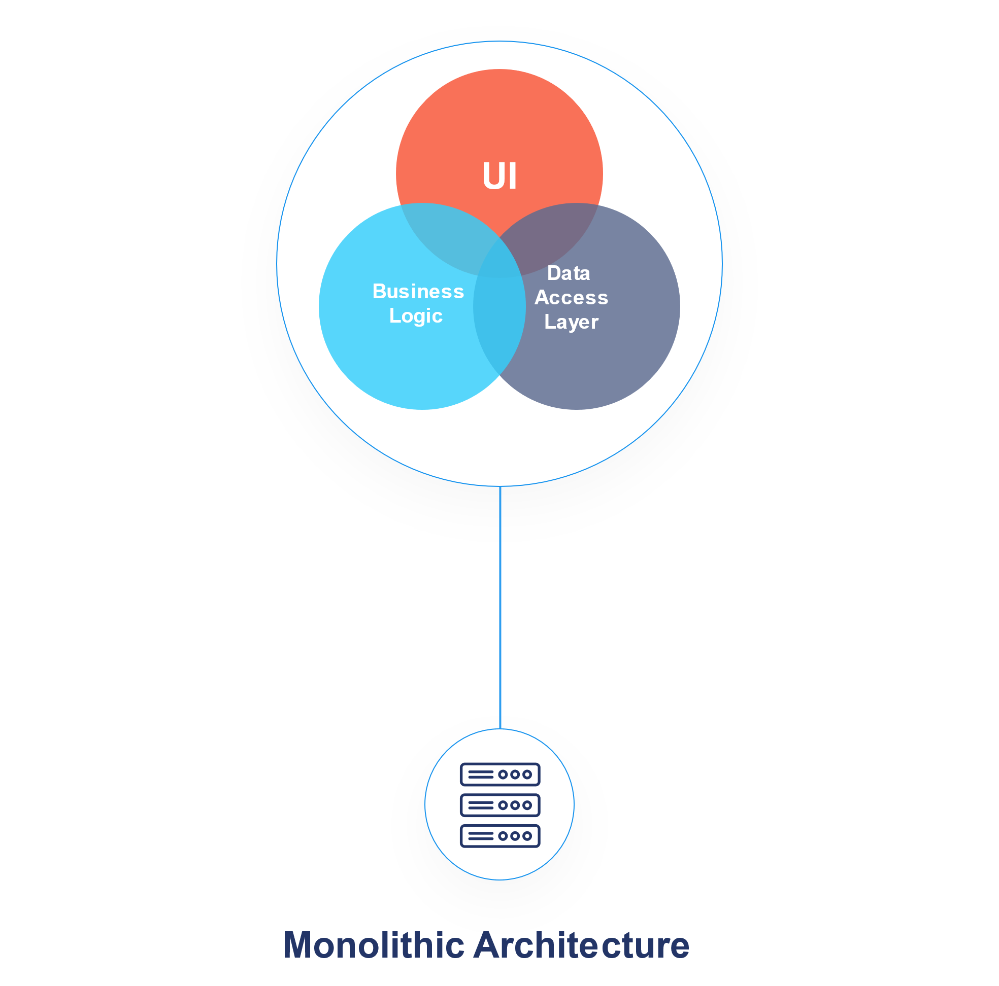
Monolith architecture (continued)

Slide 5
Microservice architecture
De-coupled application.
We break the application into multiple services, each service having its own business logic and database layers.
No down time.
A service can communicate with other services.
The API Gateway is responsible for request routing, composition, and protocol translation.
Each and every microservice in your system must have a well-defined and documented API. This API is the “contract” that exists between different service owners.

Slide 6
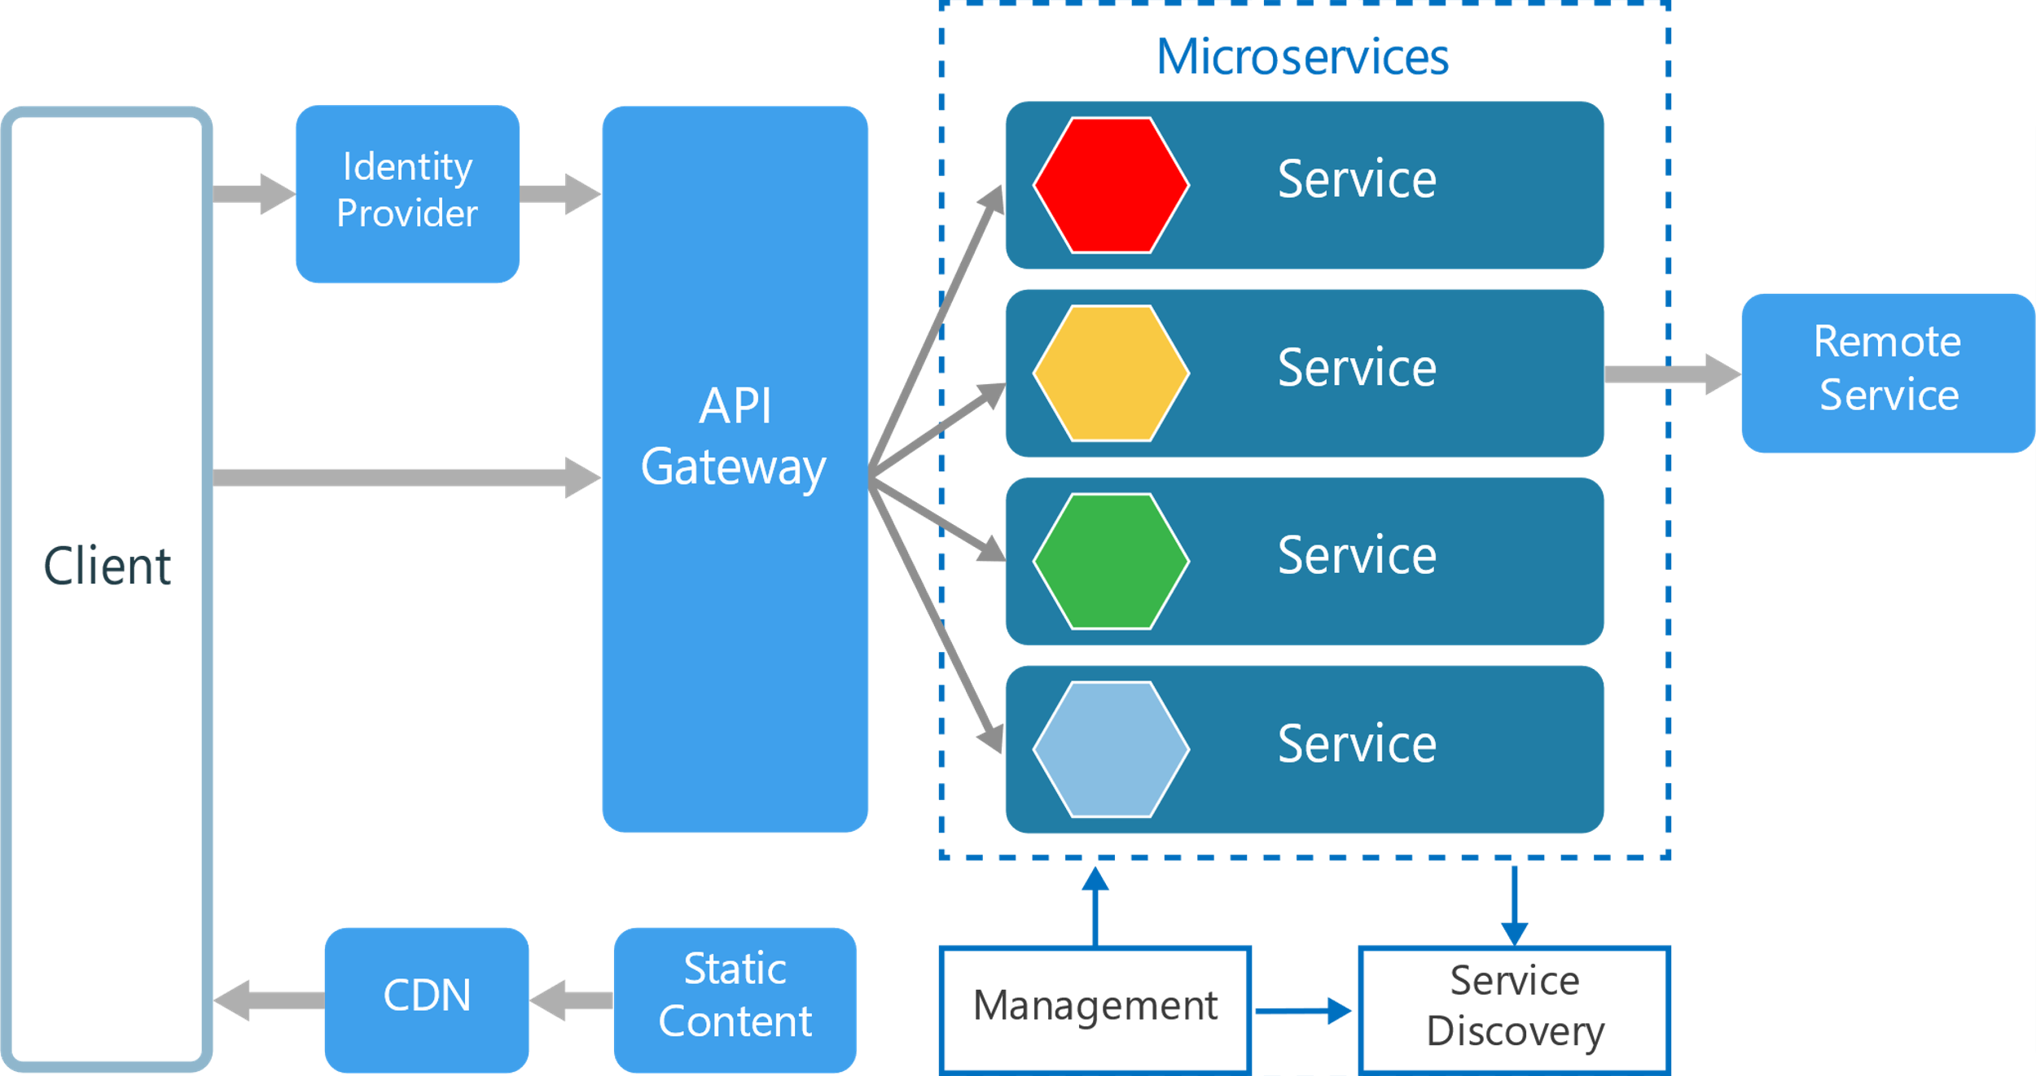
Microservice architecture (continued)

Slide 7
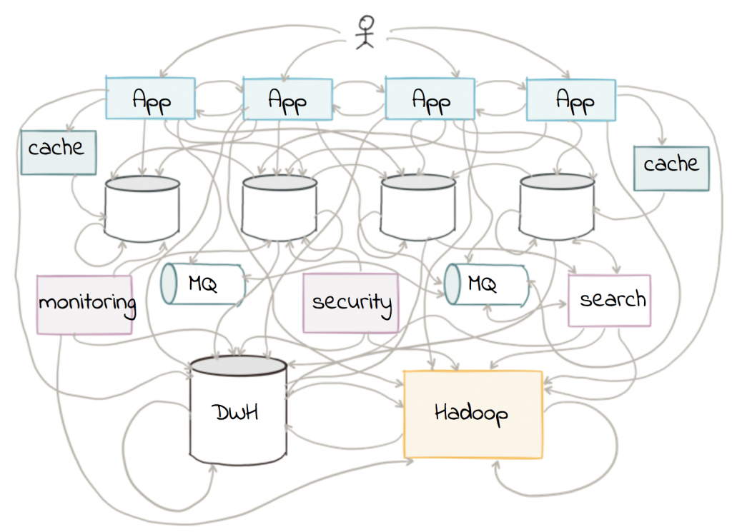
Microservice architecture (continued)

Slide 8
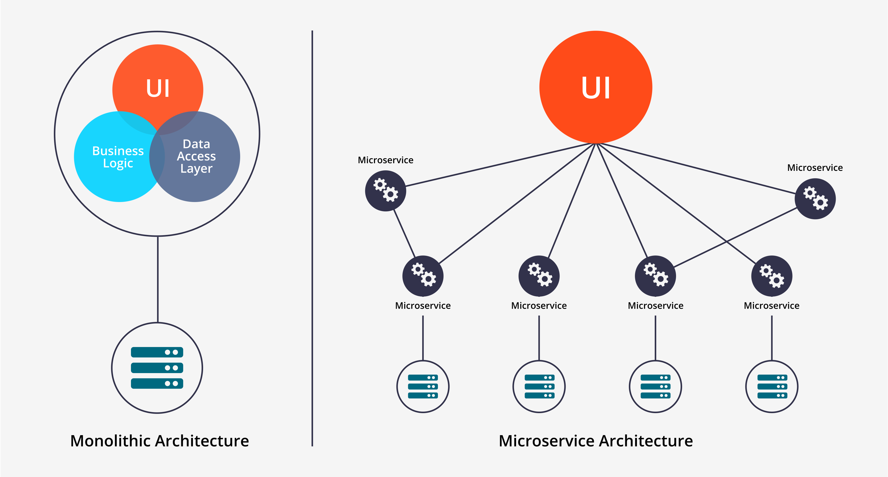

Slide 9
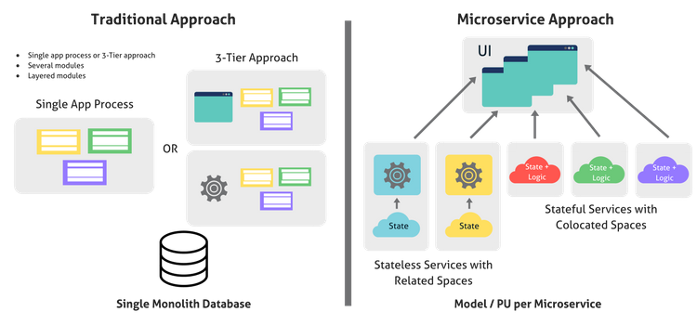

Slide 10
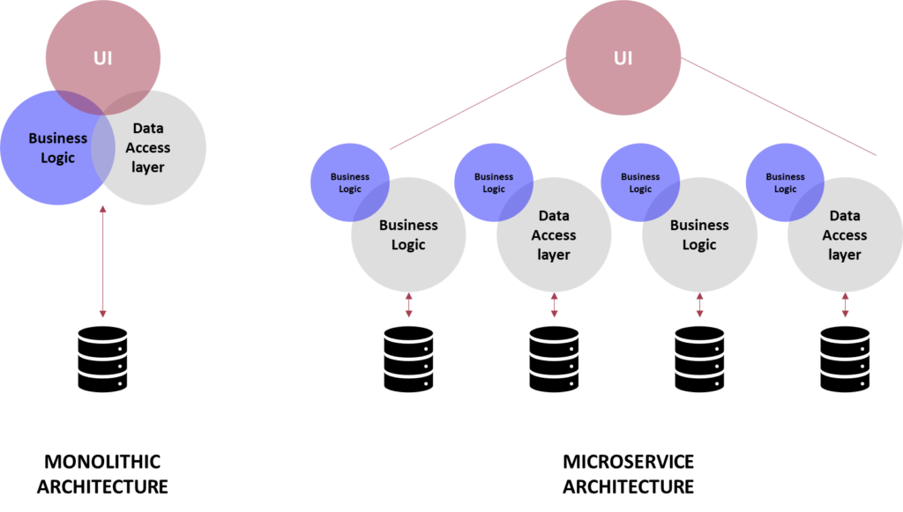

Slide 11
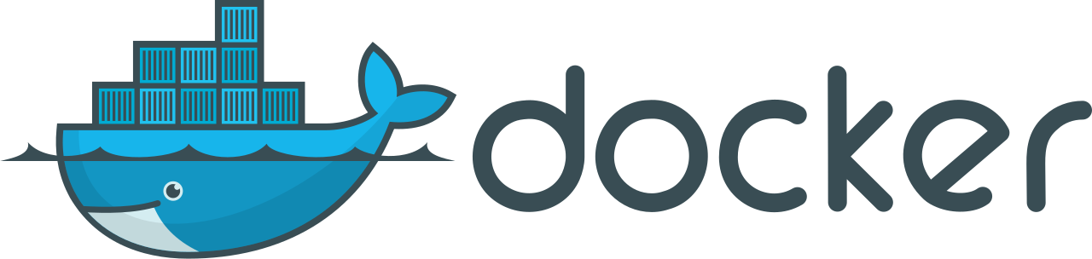
docker
Docker was build to make containers.
Docker is not responsible for managing our containers.
Problem: We need an orchestration tool! ☹
Solution: Kubernetes ☺

Slide 12
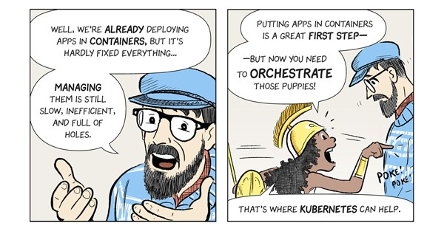

Slide 13
Problems before kubernetes

Slide 14
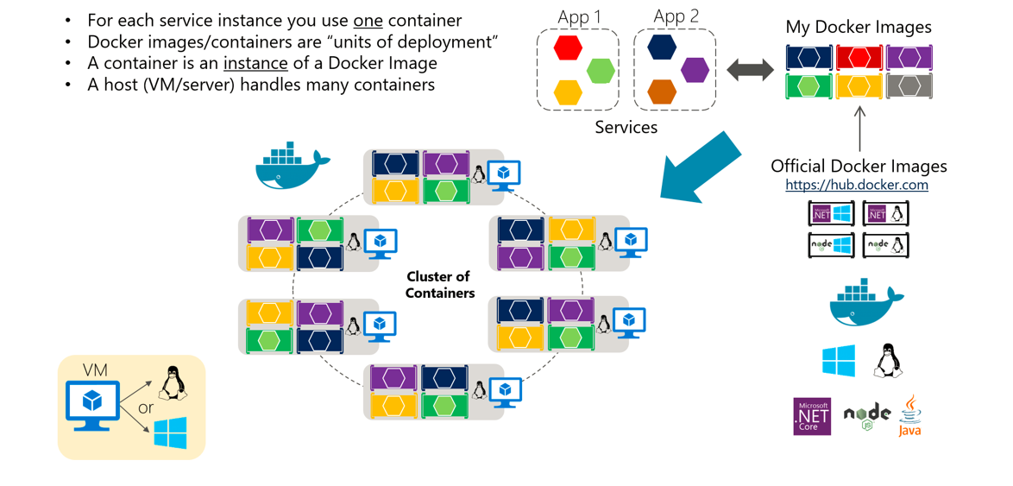
Problems
Hard to manage multiple stacks, and multiple applications. (hard to manage dockerfiles, docker-compose files and application directories).

Slide 15
Problems (Continued)
Deploying multiple application containers, updating containers, and scheduling containers on different nodes is not easy.

Slide 16
Problems (Continued)
Large deployments. (hard to manage hundreds, and thousands of containers).

Slide 17
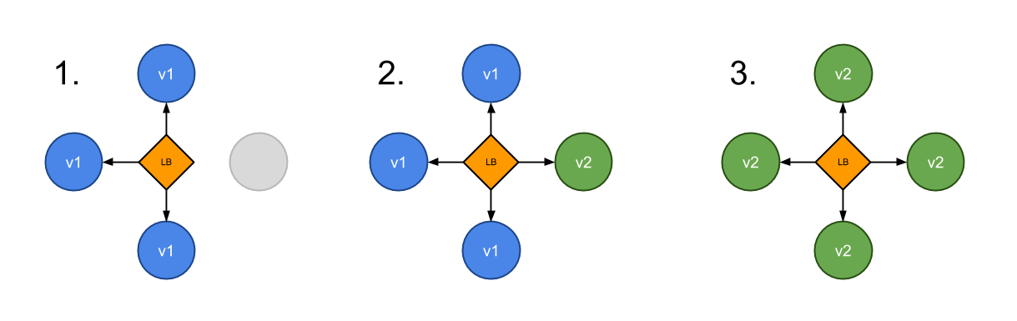
Problems (Continued)
No canary pattern deployments (some users at older version of the application and some users at newer version of the application).

Slide 18
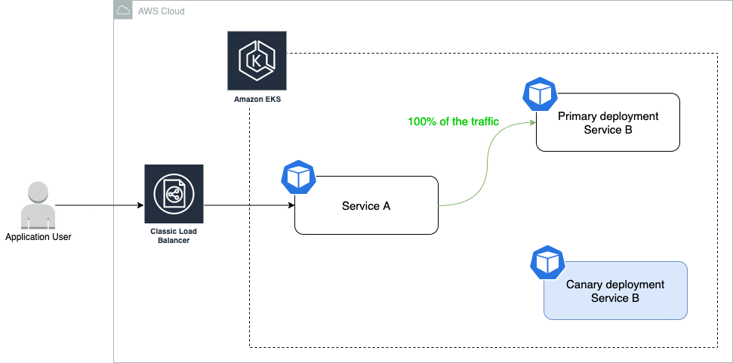

Slide 19
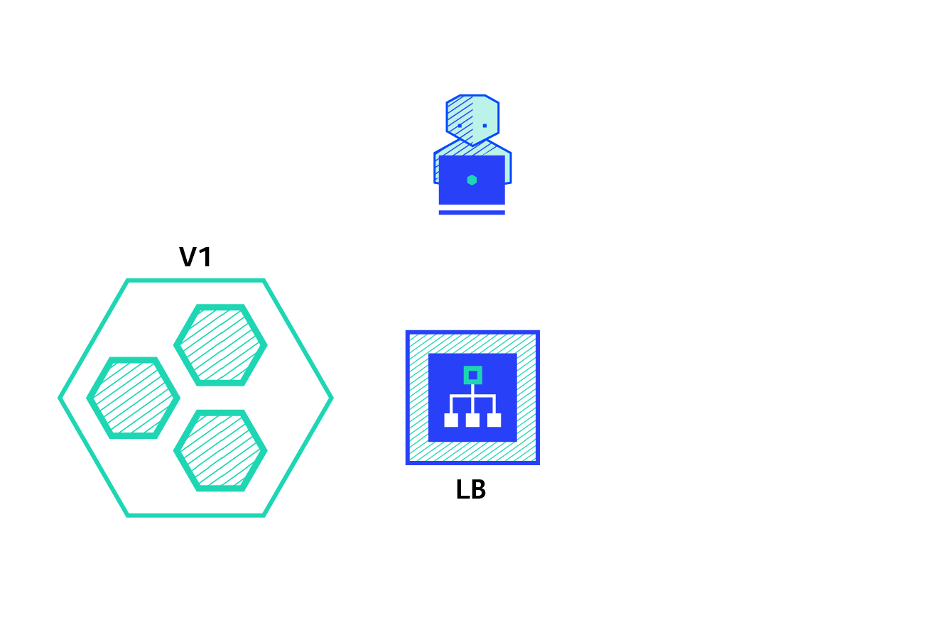

Slide 20
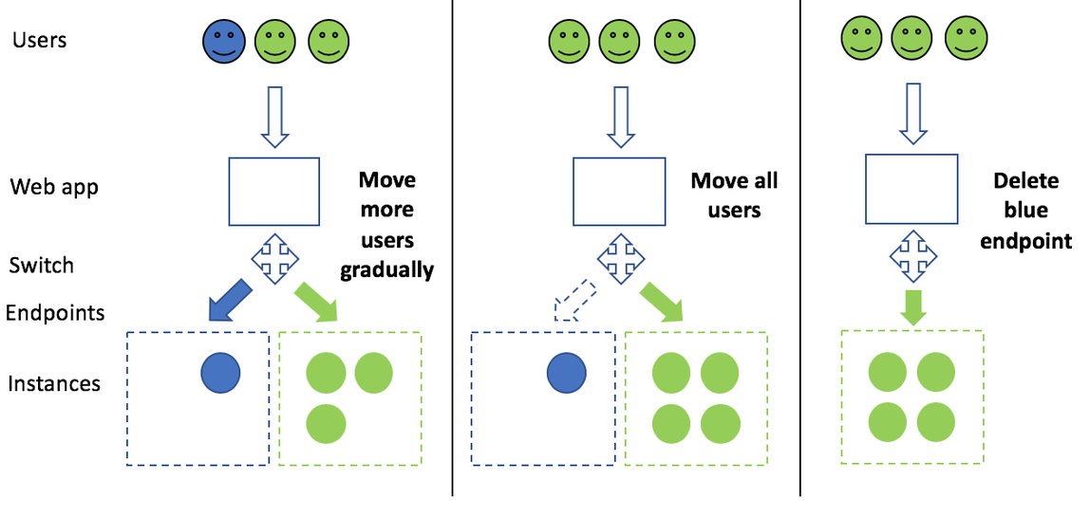

Slide 21
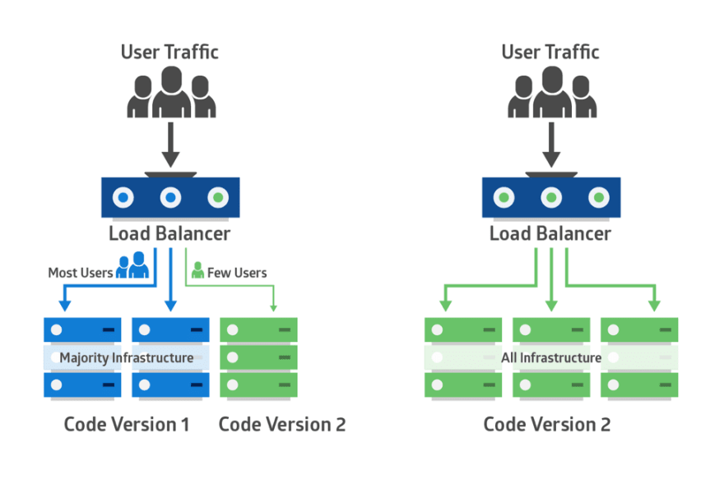

Slide 22
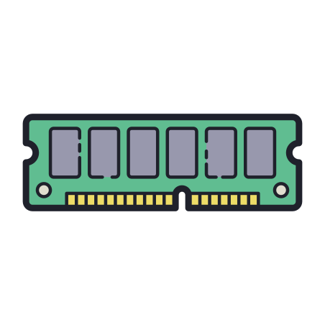
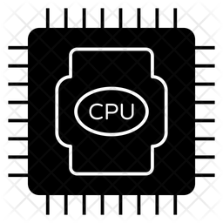
Problems (Continued)
Containers resource management (CPU, GPU, RAM, Storage etc.)
It is hard to manage resource allocation when we have hundred and thousands of containers in our clusters.

Slide 23
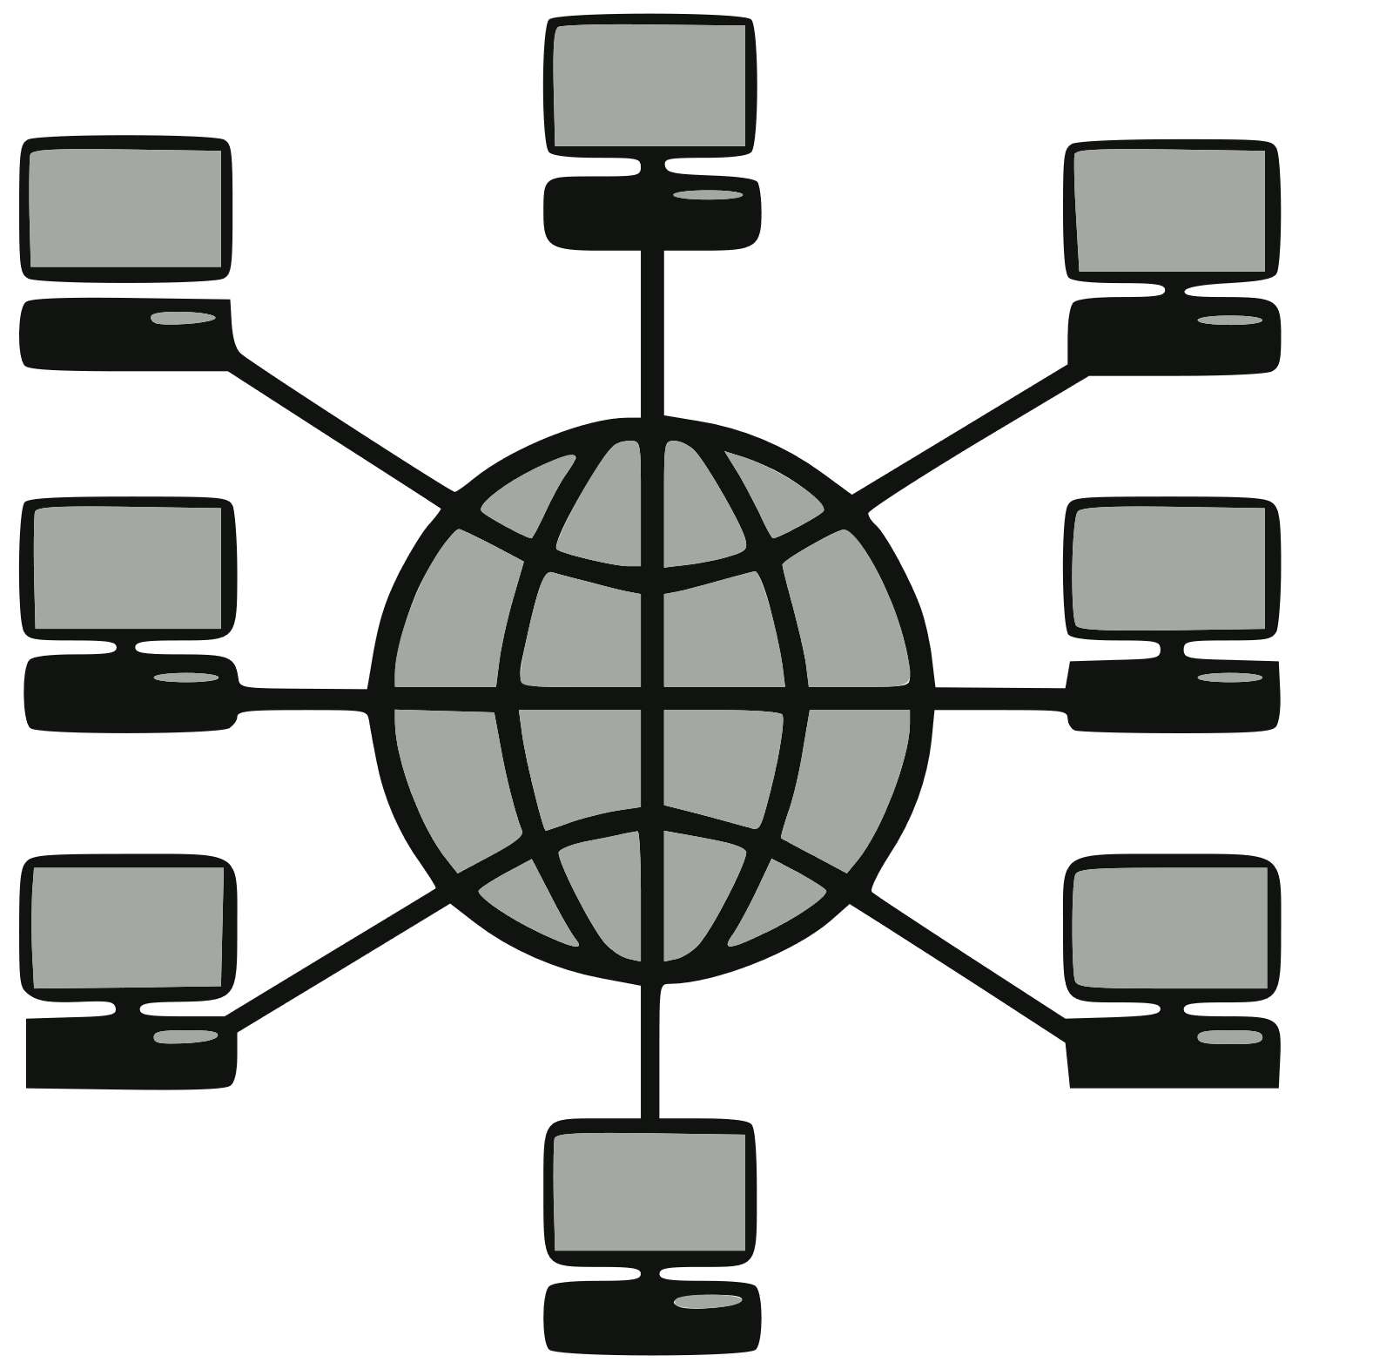
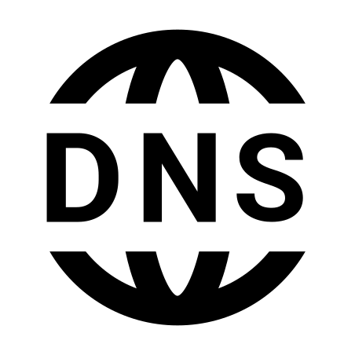
Problems (Continued)
It is not possible to deal with the Networking and DNS configuration for each container separately.

Slide 24
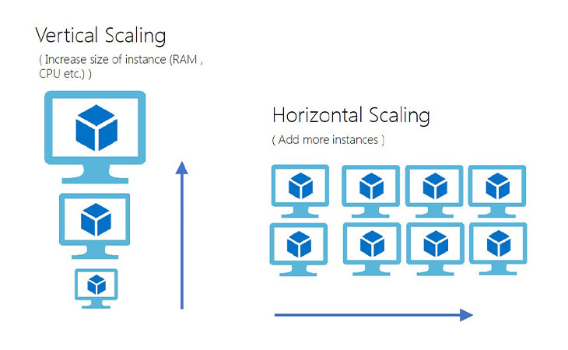
Problems (Continued)
High availability and scaling, “Automatically” horizontal and vertical scaling is not possible for multiple containers.

Slide 25
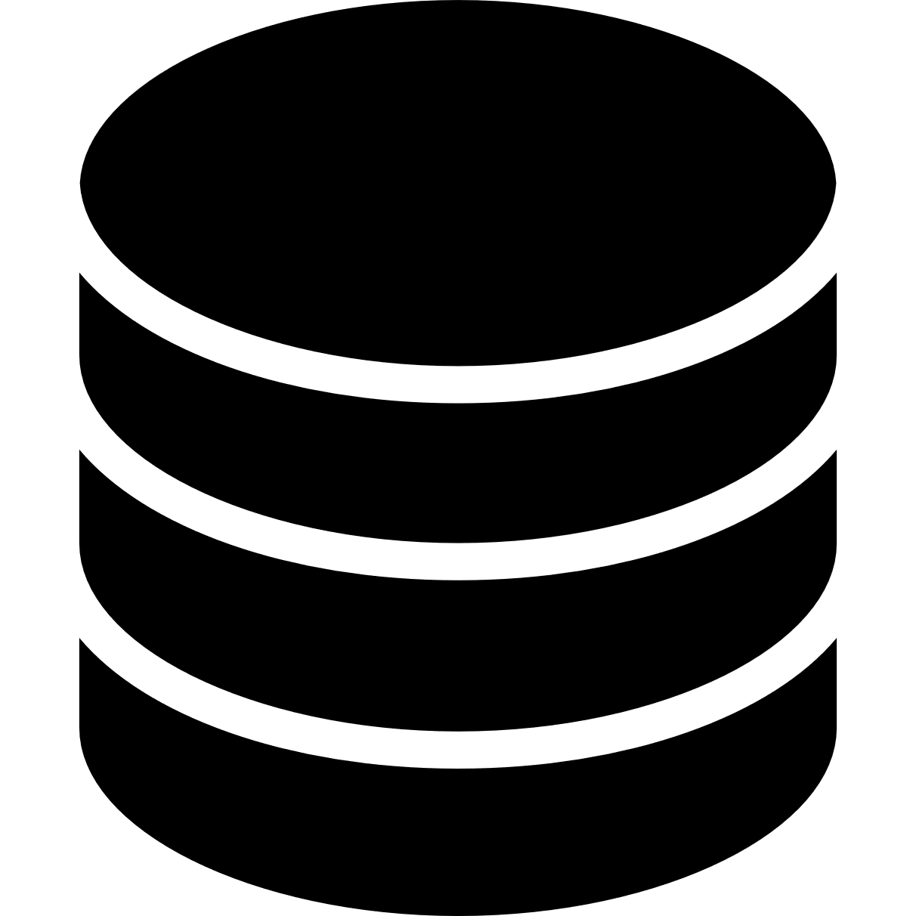

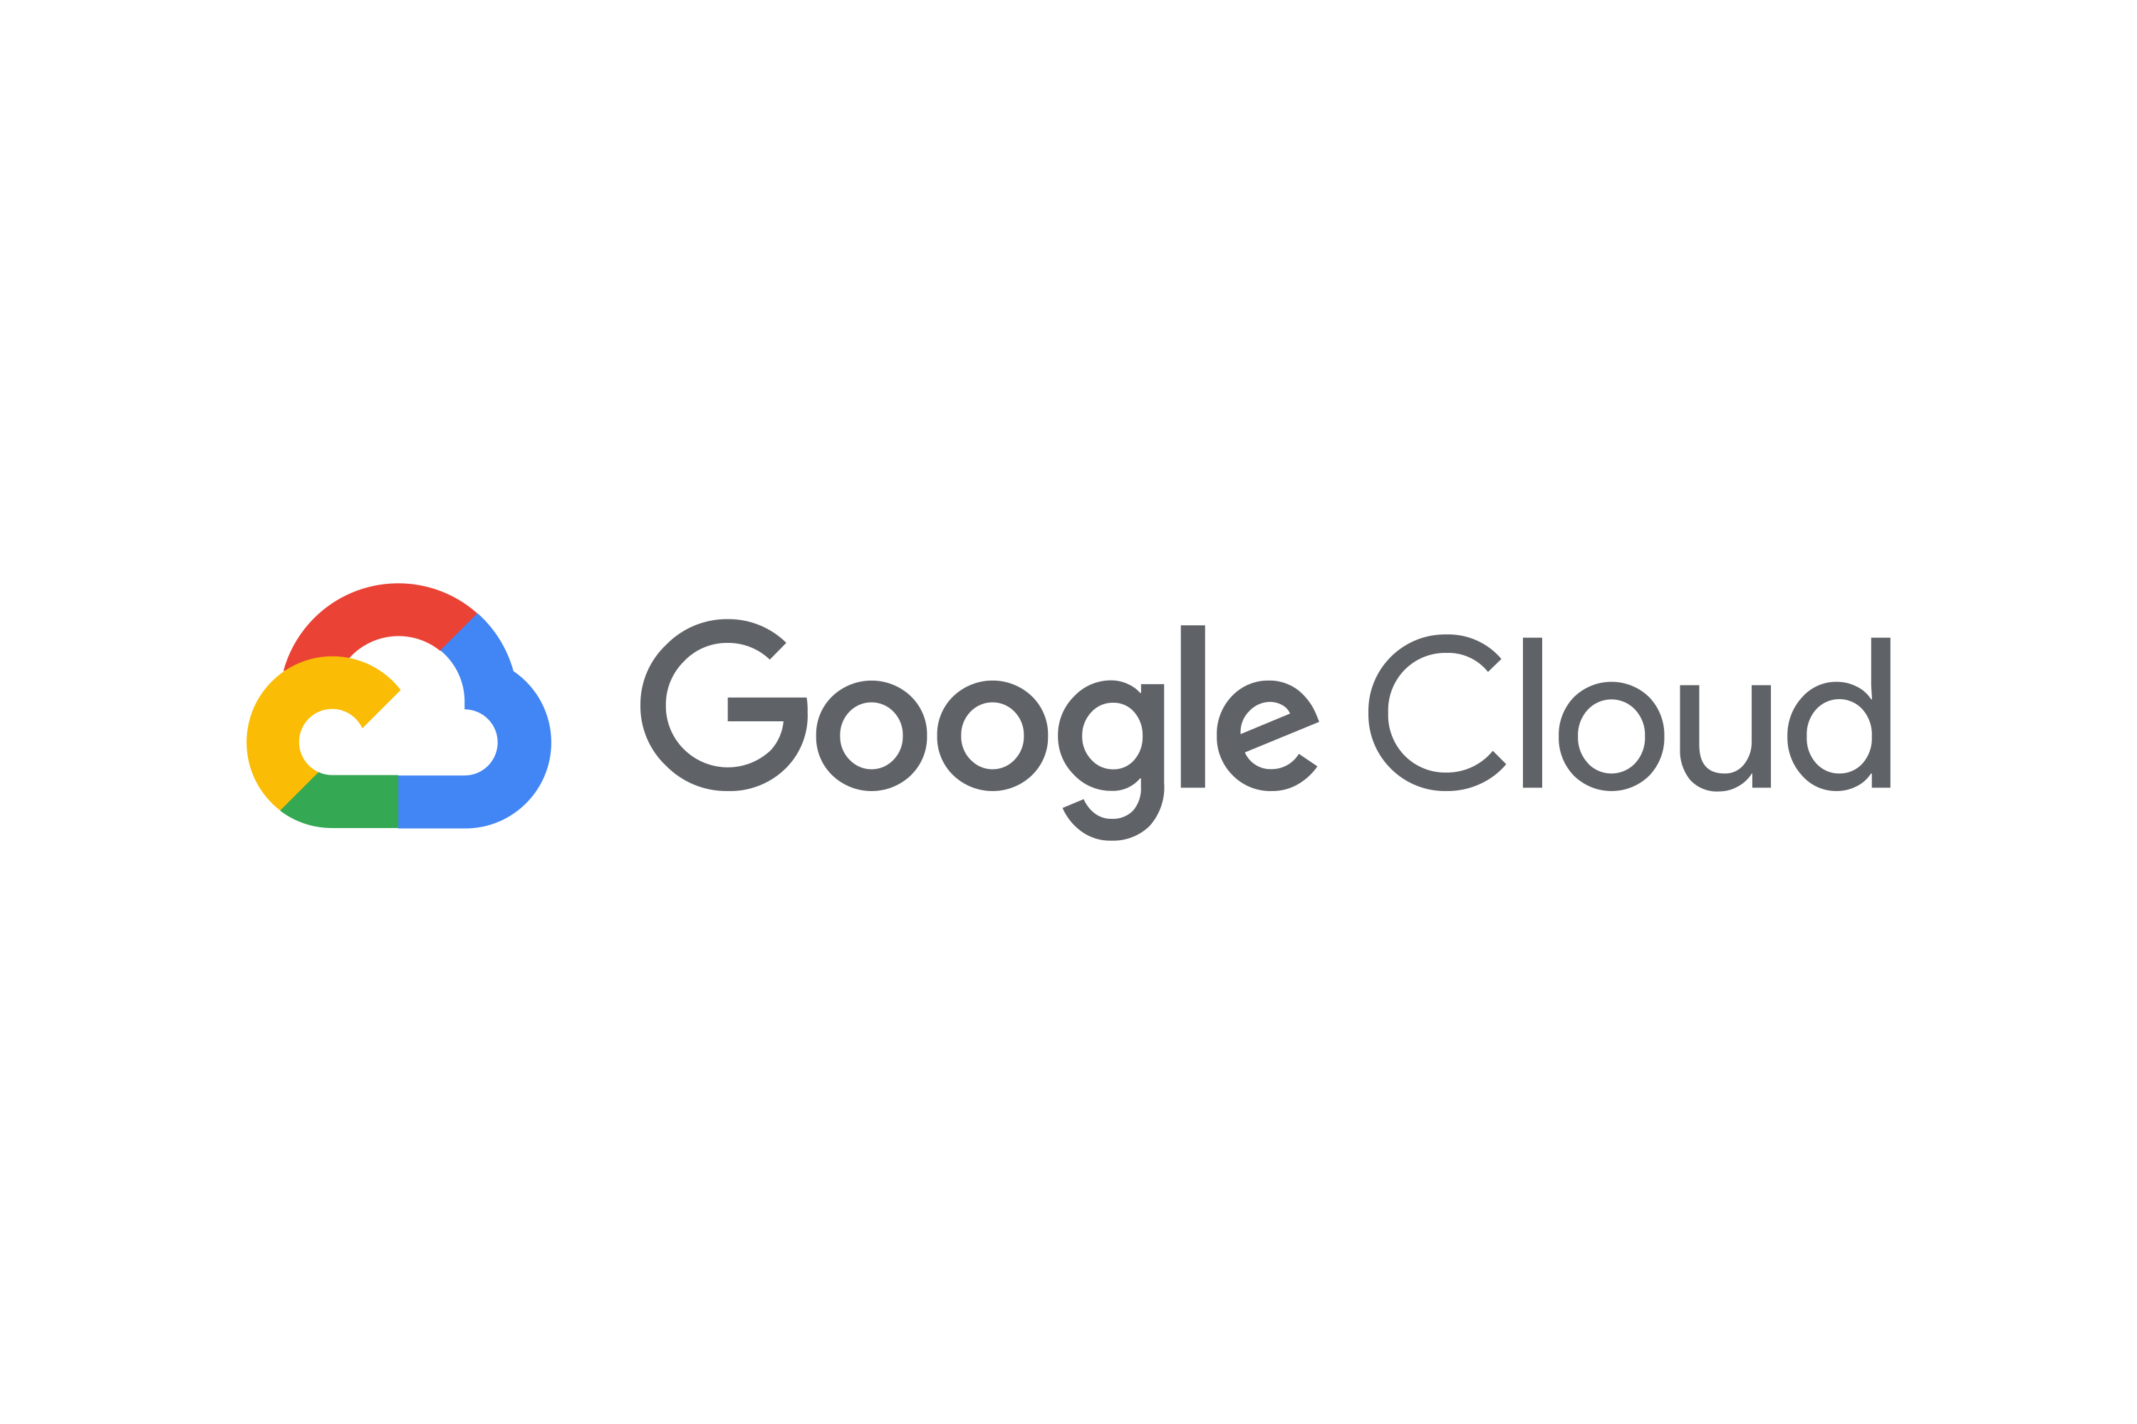

Problems (Continued)
We can only use local storage.
We can’t use NFS, GCEP, AWS EBS, iSCSI etc.

Slide 26

Problems (Continued)
Resilience (try to provide service even if something fails by creating new containers automatically).

Slide 27
Problems (Continued)
No Service discovery.
Different services can easily communicate with each other, this helps in the microservice architecture.

Slide 28
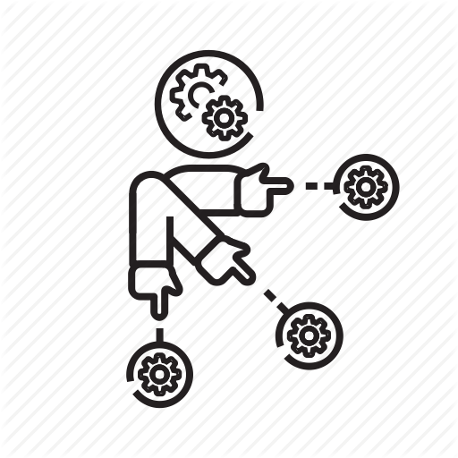
Problems (Continued)
Simplification of infrastructure, we want to schedule heavy-weight containers to high computing nodes/servers and light-weight containers to average computing nodes/servers automatically.

Slide 29
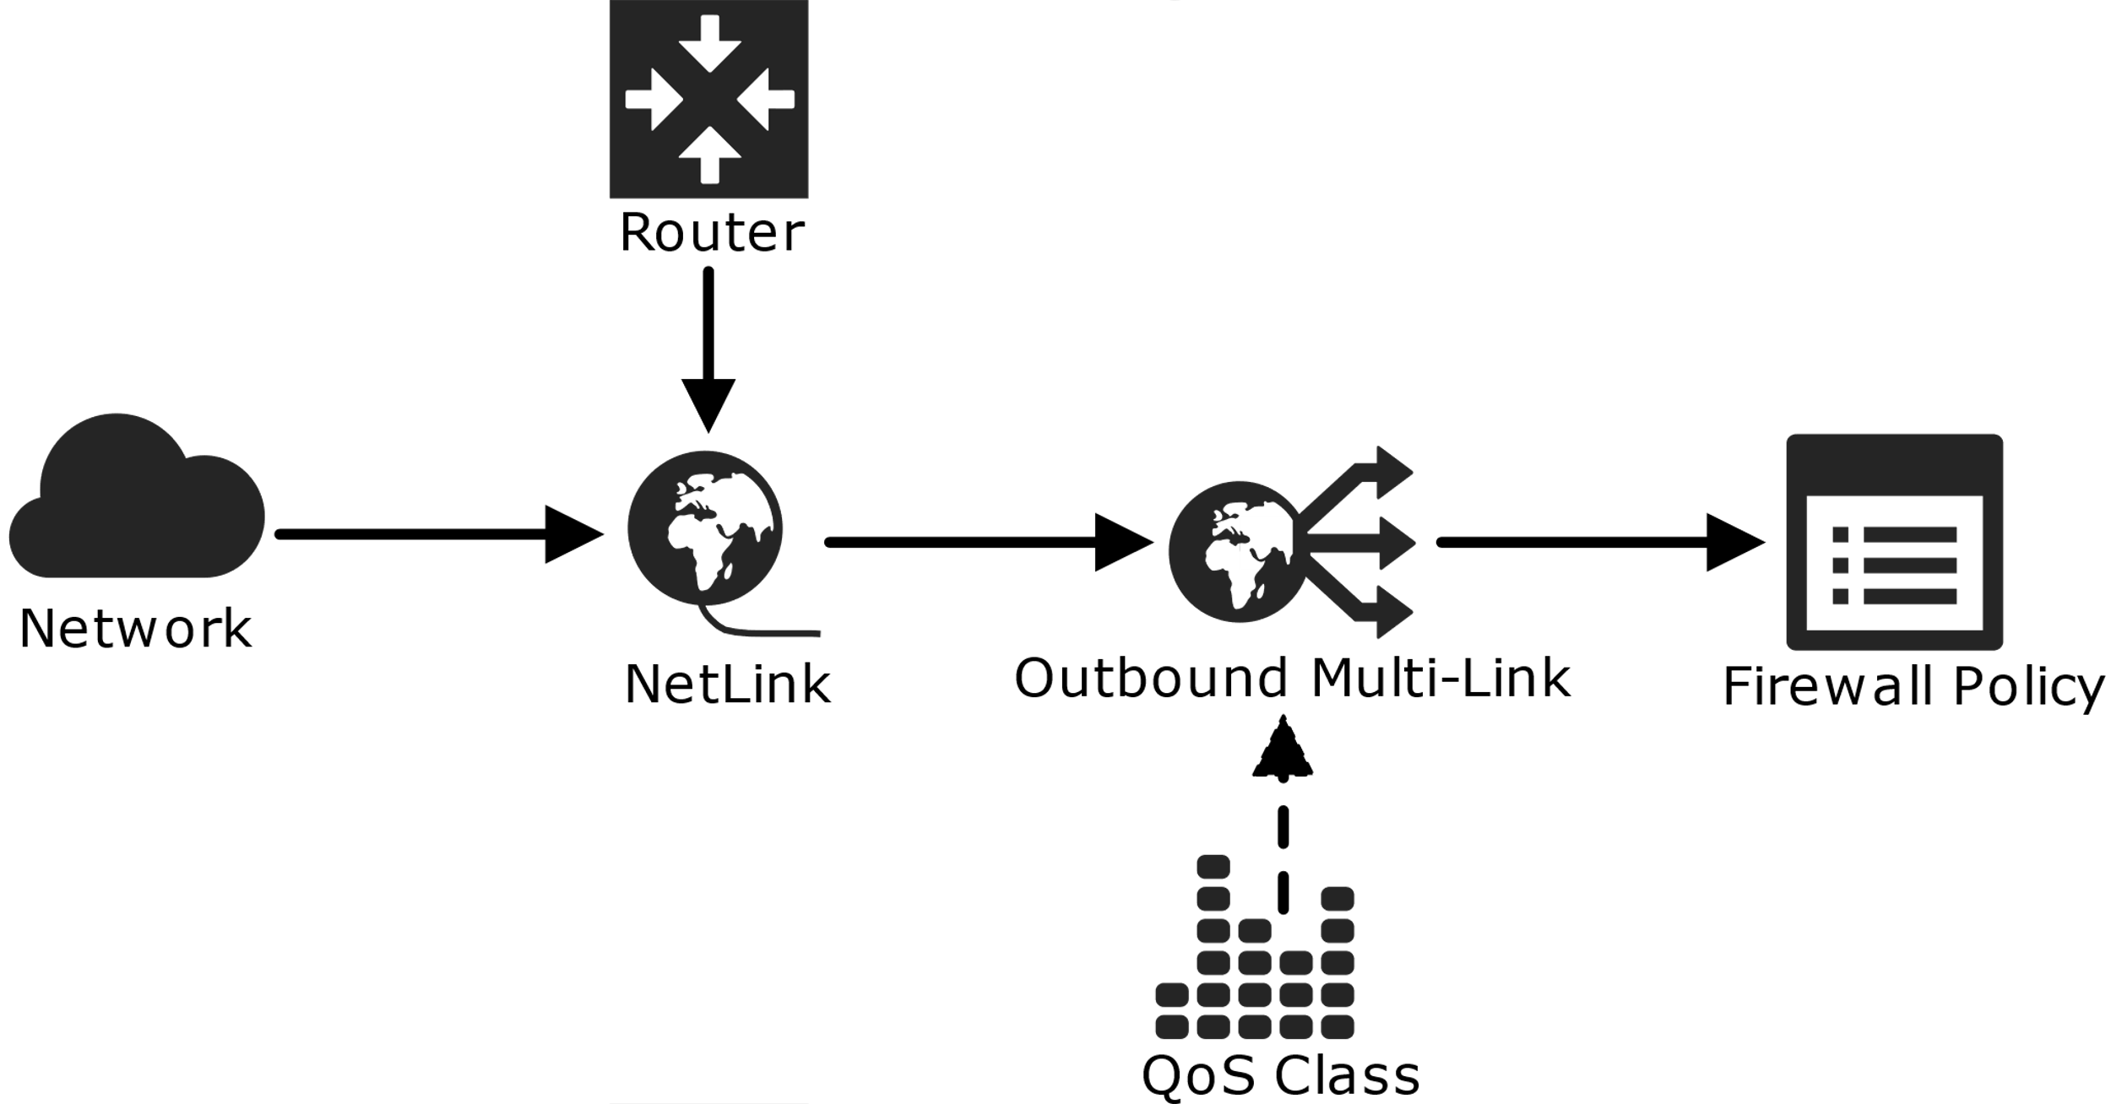
Problems (Continued)
Ingress (traffic management).

Slide 30
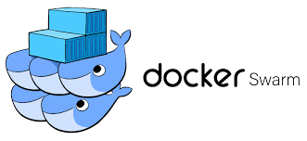

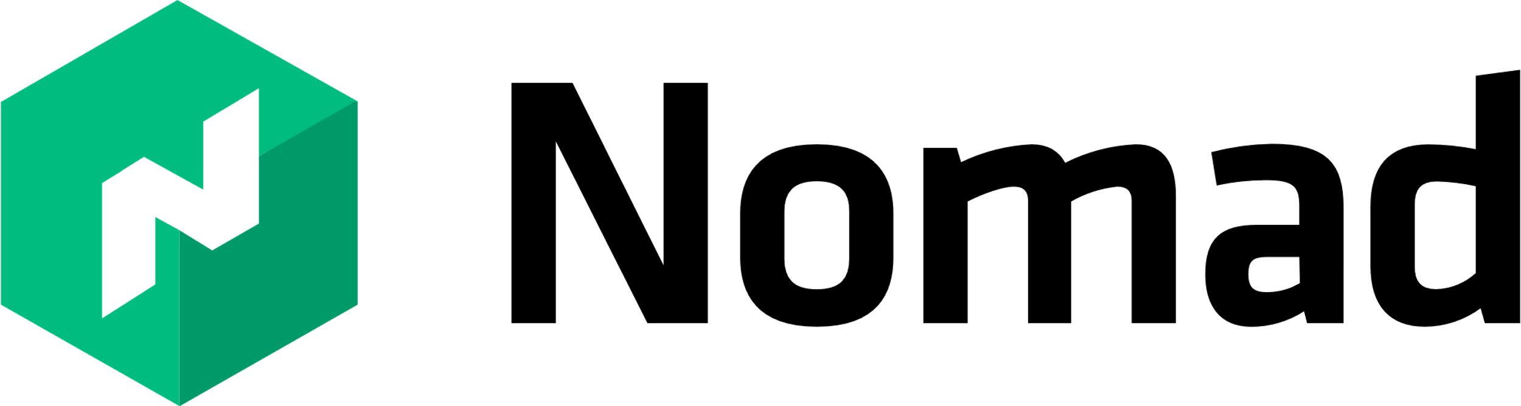
Solutions (container management tools)

Slide 31
Introduction to kubernetes
Kubernetes is an open-source container-orchestration system (containers management tool) for automating computer application deployment, scaling, and management. It was originally designed by Google and is now maintained by the Cloud Native Computing Foundation.
Old name: Google's Borg system.
Initial release: 7 June 2014 (It was already there as Google's Borg system and was used by Google for almost 10 years).
License: Apache License 2.0.
Programming language: Go Language.
Developer: Google, Open-source software, Rancher Labs, Cloud Native Computing Foundation.
Multiple container engine support is available, not just docker engine.

Slide 32

What does “kubernetes” mean?
A Greek word which is pronounced as “Kee Ver Ne Tees” in Greek.
Means "pilot" or "helmsman of a ship“.

Slide 33
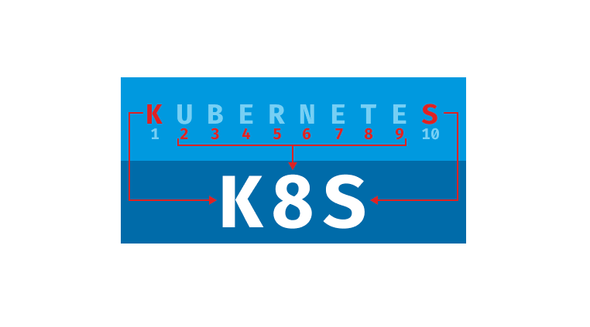

Slide 34
Why kubernetes
It was stable and used by Google in production environment for almost 10 years before it was released as an open source product. Tools like docker swarm, and mesos were new in the market, they were unstable with few features, and support as compared to Kubernetes.
It has more features, and support.
90% market share.

Slide 35
Docker and kubernetes relation
Docker is a tool that uses a container runtime called “containerd” to make containers easily.
Kubernetes does not require any tool like docker, it can directly communicate with a container runtime like “containerd” to make containers but to reduce complexities, it uses these container engine tools.
Kubernetes uses docker to make containers but it supports other container engine tools also.

Slide 36
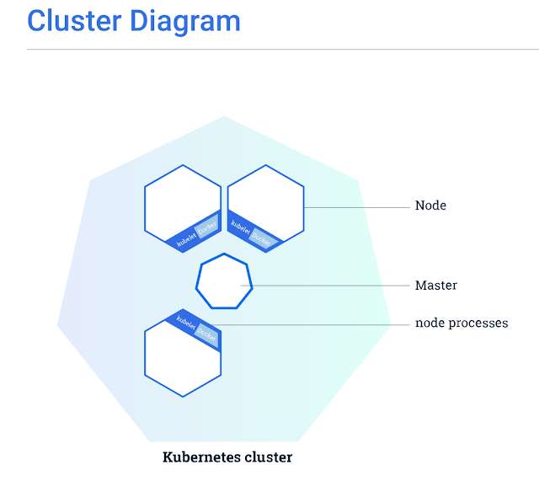

Slide 37
Kubernetes main components
There are 5 main internal components in kubernetes. 3 components works at master nodes (control plane nodes) and 2 components works at worker nodes.
Components at master nodes (control plane nodes) includes: 1. API server or API process 2. Controller manager 3. Scheduler. It also has a database component (etcd) at master node but it is an external component that kubernetes use to store data.
Components at worker node includes: 1. Kubelet 2. Kube-proxy Worker node also has a container runtime which can be any container runtime providing tool e.g. docker.

Slide 38
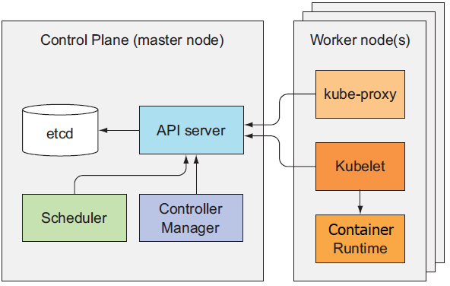

Slide 39
Master or control plane nodes
We can have multiple master nodes. An administrator/user only communicates with the master node to tell his/her desires (the state of a kubernetes cluster), we do not communicate with the worker nodes, we create worker nodes using the master node but we do not communicate with them. The master node also has an external database component to store cluster state information. In each master node, we have following main internal Kubernetes components, API server: This acts as the entrance to the Kubernetes control plane, every component communicates with this API server to pass any message to other components, there is no direct communication between the components. The worker node components (Kubelet and Kube-proxy) also communicate with this API server to pass the worker node information to the master node. The administrator also communicates with this API server to provide its desire state of the cluster using Kubectl program. Controller manager: The controller manager is responsible for controlling the state of the cluster. When you let Kubernetes know what you want in your cluster, the controller tries to convert the actual current state into desired state of the administrator/user. The controller manager first sees all the desires of an administrator and then orders the scheduler component to take actions to fulfill those desires. The controller manager ensures that all the administrator’s desires are fulfilled. Scheduler: It follows the commands given by the controller manager to it via the API-server and take actions to fulfill desires of an administrator/user. If the administrator/user does not specifies a node for a pod, it will pick the best possible node by itself.

Slide 40
worker nodes
We can have multiple worker nodes. In each worker node, we have following main internal Kubernetes components, Kube-proxy: The purpose of Kube-proxy is to manage the networking of a node. It helps in creating a bridge(a network for communication between multiple nodes/servers), helps in load-balancing between multiple nodes/servers. Kubelet: The Kubelet component in a node/server performs all the pod operations (create, delete, update, health monitoring etc.), it ensures the desire configuration of pods given by the administrator/user running inside a node.
We also have one external component like Docker to provide container runtime. Kubernetes supports many container runtime providing tools.

Slide 41
Kubernetes architecture
Kubernetes supports many container runtime providing tools e.g. Docker. However, it can use its own container runtime mechanism.

Slide 42
Kubernetes architecture (continued)
The Kubelet component in a node/server performs all the pod operations (create, delete, update, health monitoring etc.), it ensures the desire configuration of pods given by the administrator/user running inside a node.

Slide 43
Kubernetes architecture (continued)
The purpose of Kube-proxy is to manage the networking of a node. It helps in creating a bridge(a network for communication between multiple nodes/servers), also helps in load-balancing between multiple nodes/servers.

Slide 44
Kubernetes architecture (continued)
Kubernetes stores all the information related to the cluster in a key-value pair database like etcd database. It is an external component of master node.

Slide 45
Kubernetes architecture (continued)
The API Server services REST operations and provides the frontend to the cluster's shared state through which all other components interact. The components does not communicate directly with each other, they do indirect communication using this API-server.

Slide 46
Kubernetes architecture (continued)
The controller manager is responsible for controlling the state of the cluster. When you let Kubernetes know what you want in your cluster, the controller tries to convert the actual current state into desired state of the administrator/user. The controller manager first sees all the desires of an administrator and then orders the scheduler component to take actions to fulfill those desires. The controller manager ensures that all the administrator’s desires are fulfilled.

Slide 47
Kubernetes architecture (continued)
It follows the commands given by the controller manager to it via the API-server and take actions to fulfill desires of an administrator/user. If the administrator/user does not specifies a node for a pod, it will pick the best possible node by itself.

Slide 48
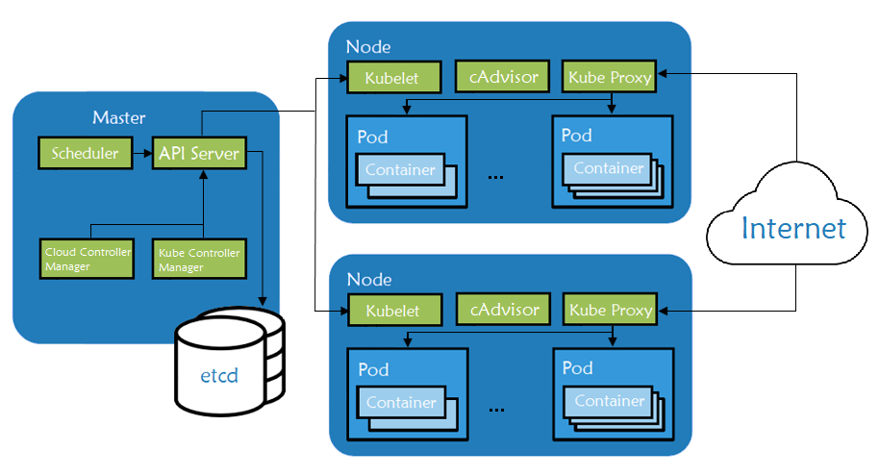
Kubernetes architecture (continued)
A pod is a smallest working unit in Kubernetes, it can have many containers running in it and if a single container stops or fails, the entire pod is deleted by Kubernetes and a new pod is created to fulfil the current desire with same application containers this is how Kubernetes provides resilience.

Slide 49
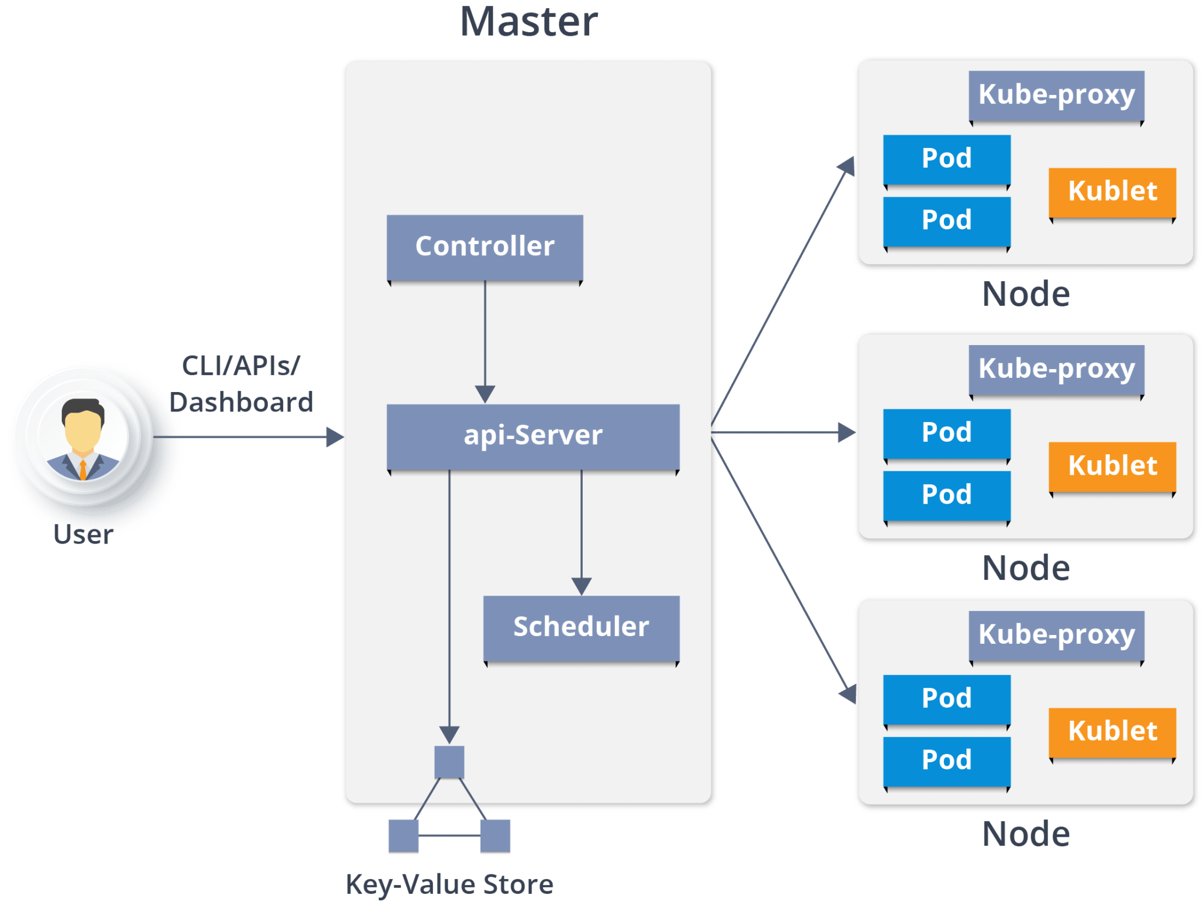
Kubernetes architecture (continued)

Slide 50
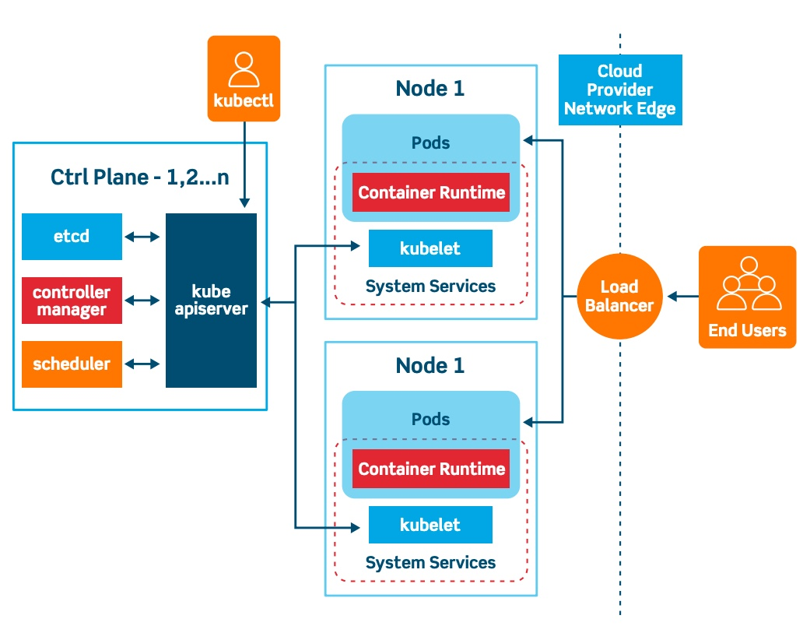
Kubernetes architecture (continued)

Slide 51
Host/Node/server/worker/slave
A node in kubernetes looks similar to a host machine in docker but instead of running containers directly, it creates pods (wrappers) and multiple containers are created in each of these pods. Pods are created connected on a same network bridge of host/node/server.
Each host/node/server has its own namespace called “root” namespace.
Each pod in a node also have their own namespace. These namespaces are connected with bridge network of host/node/server so that all the pods in a node can have similar network.

Slide 52
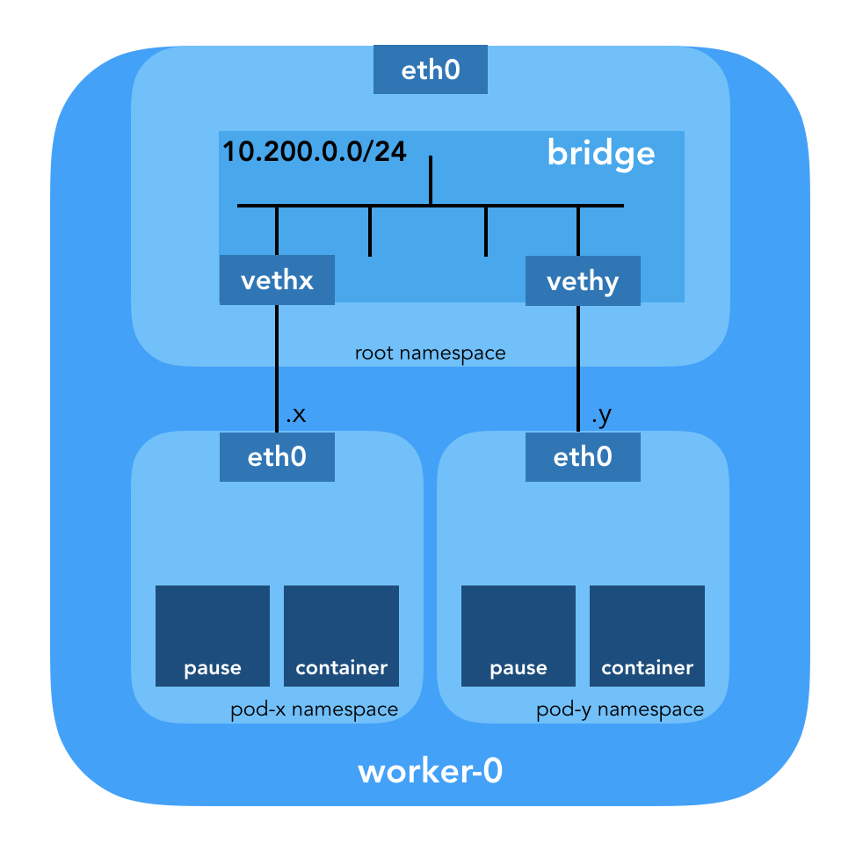
Communication between pods

Slide 53
Pods
In terms of Docker concepts, “A Pod is similar to a group of Docker containers with shared namespaces and shared filesystem volumes.”
The shared context of a Pod is a set of Linux namespaces, cgroups, and potentially other facets of isolation - the same things that isolate a Docker container. Within a Pod's context, the individual applications may have further sub-isolations applied.
Kubernetes only assigns IP addresses to pods and every container running inside that pod will be using that IP address but a different port.

Slide 54
Pods (continued)
Pods are the smallest deployable units of computing that you can create and manage in Kubernetes.
As well as application containers, a Pod can contain init containers that run during Pod startup. You can also inject ephemeral containers for debugging if your cluster offers this. A pod can have multiple containers running in it of any type.
A Pod is a group of one or more containers, with shared storage and network resources, and a specification for how to run the containers.
The containers inside a pod live together, die together, share resources.

Slide 55
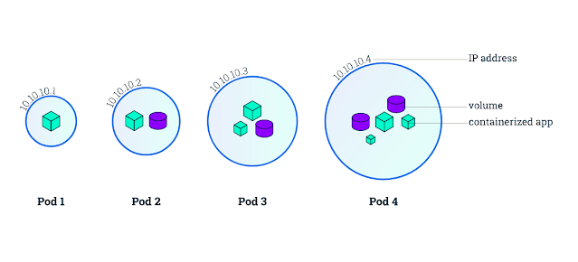
Pods (Continued)

Slide 56
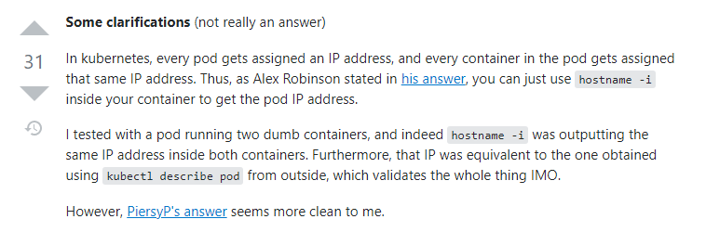
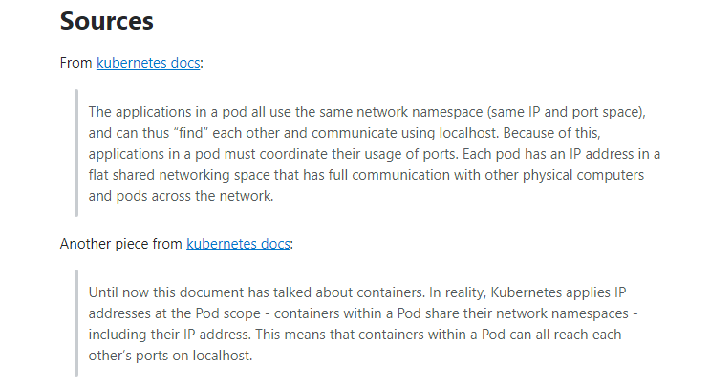
Important point for multi container pods.

Slide 57
Pods usage
Pods in a Kubernetes cluster are used in two main ways,
1. Pods that run a single container. The "one-container-per-Pod" model is the most common Kubernetes use case; in this case, you can think of a Pod as a wrapper around a single container; Kubernetes manages Pods rather than managing the containers directly. 2. Pods that run multiple containers that need to work together. A Pod can encapsulate an application composed of multiple co-located containers that are tightly coupled and need to share resources. These co-located containers form a single cohesive unit of service—for example, one container serving data stored in a shared volume to the public, while a separate sidecar container refreshes or updates those files. The Pod wraps these containers, storage resources, and an ephemeral network identity together as a single unit.

Slide 58
Points to remember for pods
Note: Grouping multiple co-located and co-managed containers in a single Pod is a relatively advanced use case. You should use this pattern only in specific instances in which your containers are tightly coupled.
Most of the time we follow "one-container-per-Pod" model because by using this model, the containers are not tightly coupled.
Each Pod is meant to run a single instance of a given application. If you want to scale your application horizontally (to provide more overall resources by running more instances), you should use multiple Pods, one for each instance. In Kubernetes, this is typically referred to as replication. Replicated Pods are usually created and managed as a group by a workload resource and its controller.

Slide 59
Pause containers
The 'pause' container is a container which holds the “network namespace” for the pod and adds all the upcoming application/main containers in that namespace so that all the containers inside a pod can communicate with each other.
The pause container’s duty is to allocate an IP address for the pod and to create a namespace (wrapper) where all the containers of a pod can live together.
The pause container after allocating the IP address, holds the network namespace for the upcoming application containers and never exits and runs forever.
If pause container exits, the entire pod will be deleted by Kubernetes and Kubernetes will then create a new pod with same configuration again having a new pause container and application/main containers in that newly created pod.

Slide 60
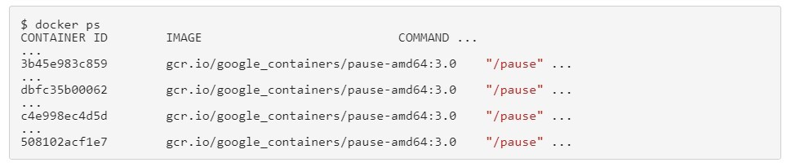
Pause containers (continued)
“Pause” is a hidden container in Kubernetes and it can not be shown using Kubernetes commands but we can see “Pause” containers by executing following docker command at any node/server/worker_node having some pods, sudo docker ps

Slide 61
Pause containers inside pods

Slide 62
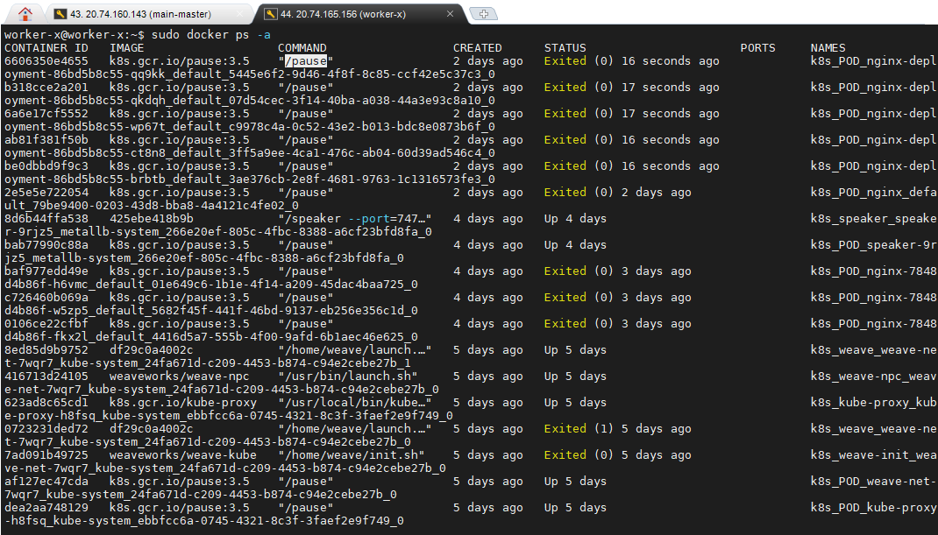

Slide 63
Init containers
Runs after the pause container allocate an IP address and holds a namespace for a pod containers.
The purpose of init container is to perform prework for the application containers. For example pulling files and storing in volume.
The init containers perform their tasks and then exits. When init container exits/stops, the pod is not deleted because pod is only deleted when an application container or the pause container stops/exits.

Slide 64
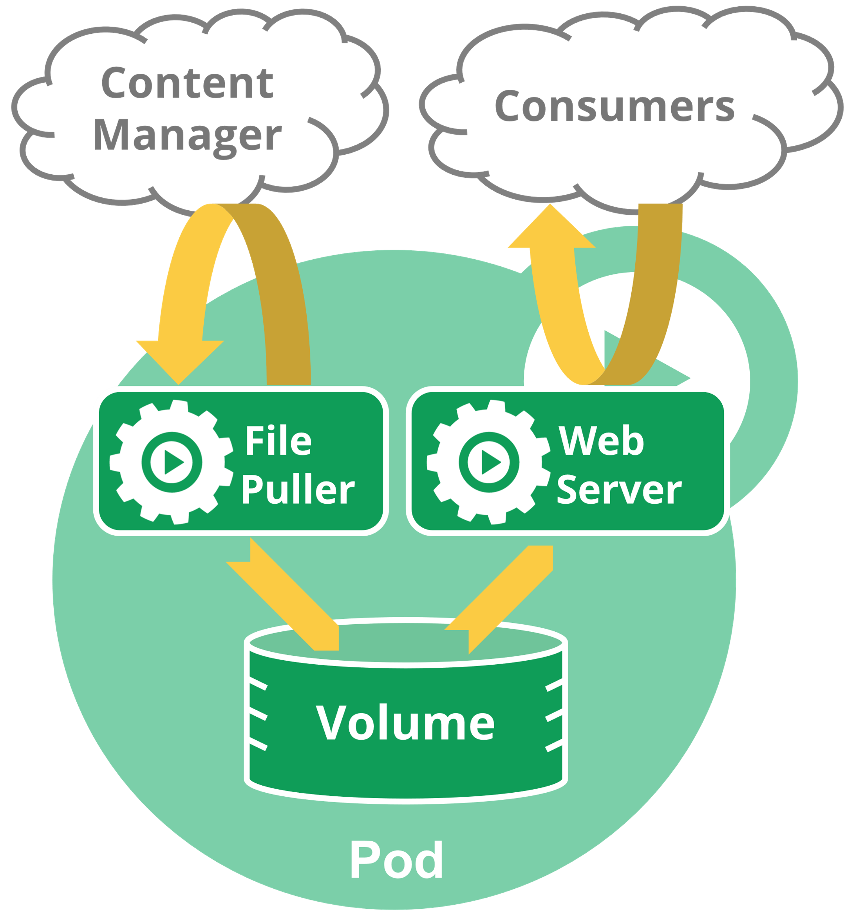
Init containers (continued)
Init Container.
Application Container.
Shared Volume.

Slide 65

Sidecar containers

Slide 66
Sidecar containers bad example
Req 80/443
If MySQL stops, the entire pod will be thrown away (deleted) and Kubernetes will make a new pod. if MySQL stops, the Nginx and NodeJS should keep running. It is a bad sidecar container example.
Kubernetes Pod
Database req
Nginx:80/433 + NodeJS:8080
MySQL:3306
App Container # 1
App Container # 2
Pause Container

Slide 67
Sidecar containers BETTER example
Req 80/443
It is good to use a proxy server to forward requests to the application server. This is a better sidecar container example. MySQL will run on a different kubernetes pod.
Kubernetes Pod
Proxy Container
Req forwarding
Nginx:80/433
NodeJS:8080
App Container # 1
App Container # 2
Pause Container

Slide 68
Sidecar containers Best example
Req 80/443
Only at “cache miss”, the request will be forwarded to the main application servers that are running on other pods of kubernetes. Merging proxy with cache is a great approach and it is a best example of sidecar containers.
Kubernetes Pod
Req forwarding
Nginx:80/433
Web Cache:53451
App Container # 1
App Container # 2
Pause Container

Slide 69
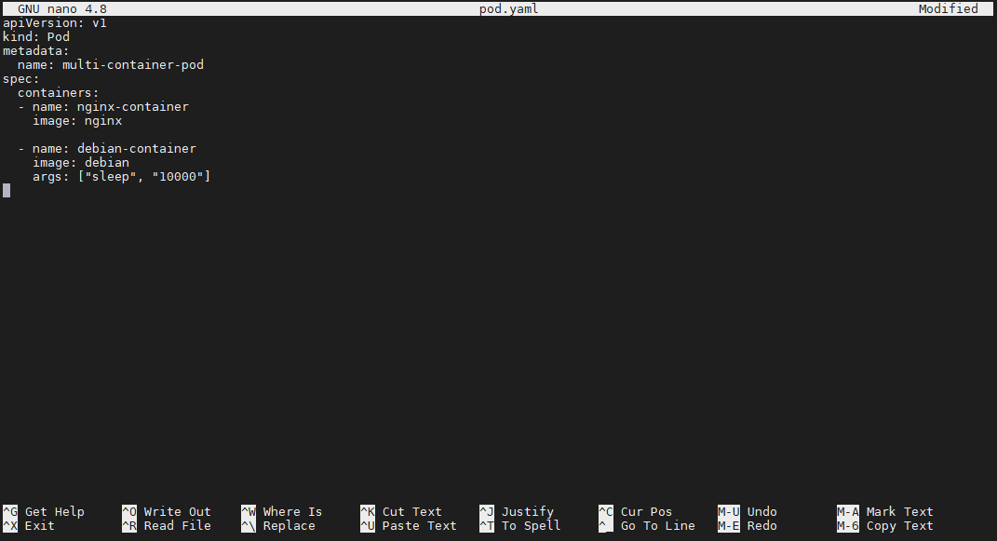

Slide 70
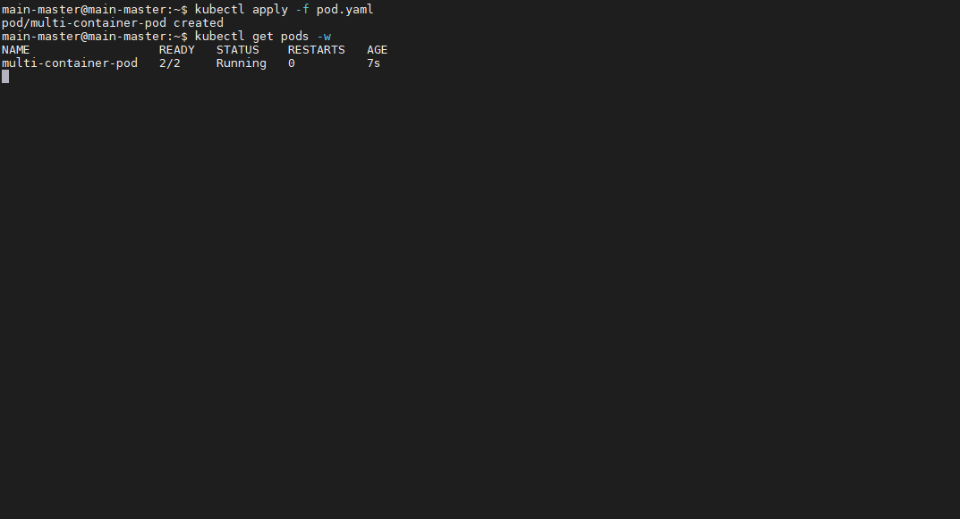

Slide 71
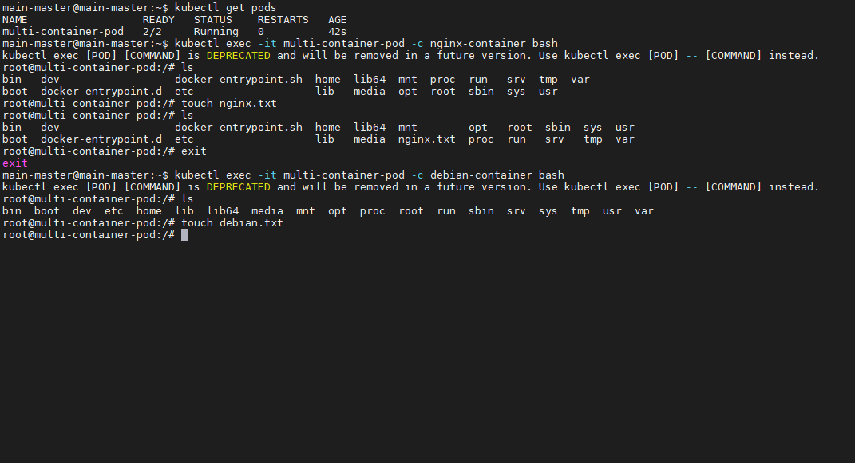

Slide 72
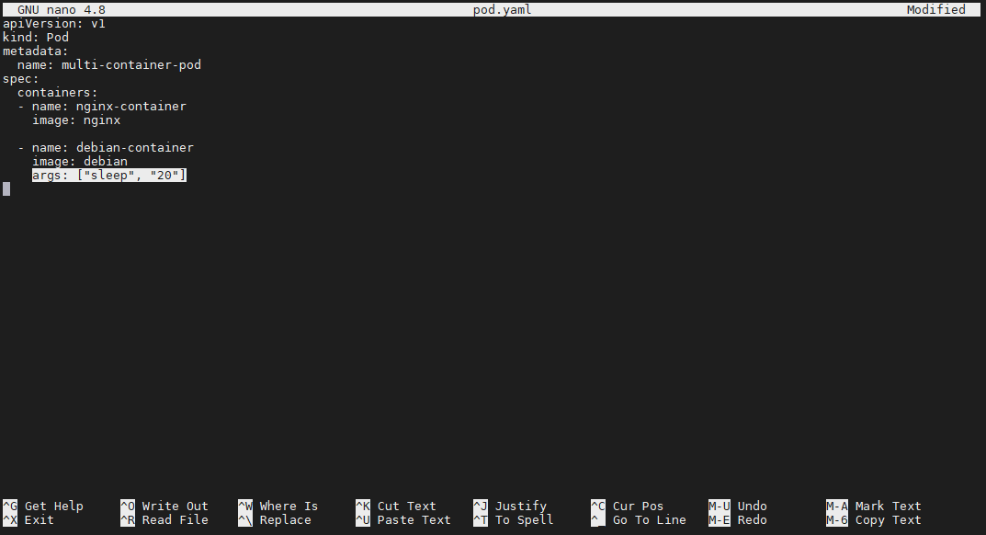

Slide 73
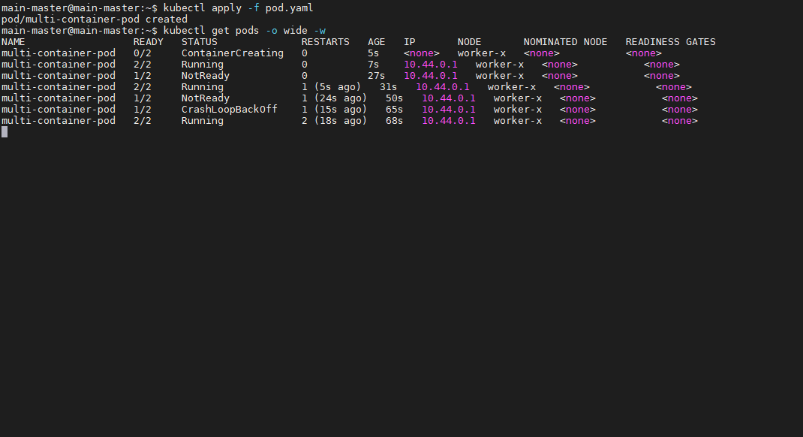

Slide 74
Init container example

Slide 75
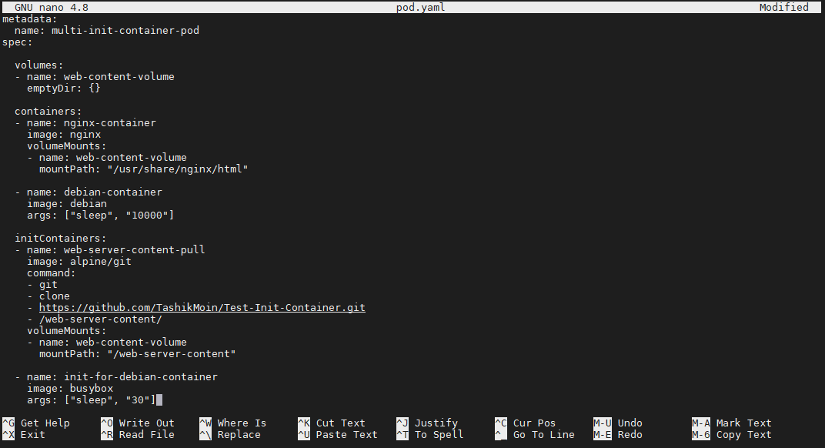
An EmptyDir type volume that will be created at pod level and it will be mounted at 2 containers, first it will be mounted inside web-server-content-pull init container that will pull web content for main nginx webserver container. Now again the same volume will be mounted to the nginx-webserver container on given path so that it can have all the content that was pulled by the init container earlier.
Path from which the webserver will serve web content. The repository contains a index.html file that will be pulled by the init container and will be stored in the EmptyDir volume that was created at pod level, now the same EmptyDir volume of pod will be mounted to the main webserver container at this given path to server web content.

Slide 76
Like sidecar containers, a pod can also have multiple init containers and a pod is only created when all the init containers are “terminated successfully”
Extra Debian container inside same pod, it can also have its init container that will do “something” but for understanding, the init container of main Debian container will sleep for 30 seconds.

Slide 77
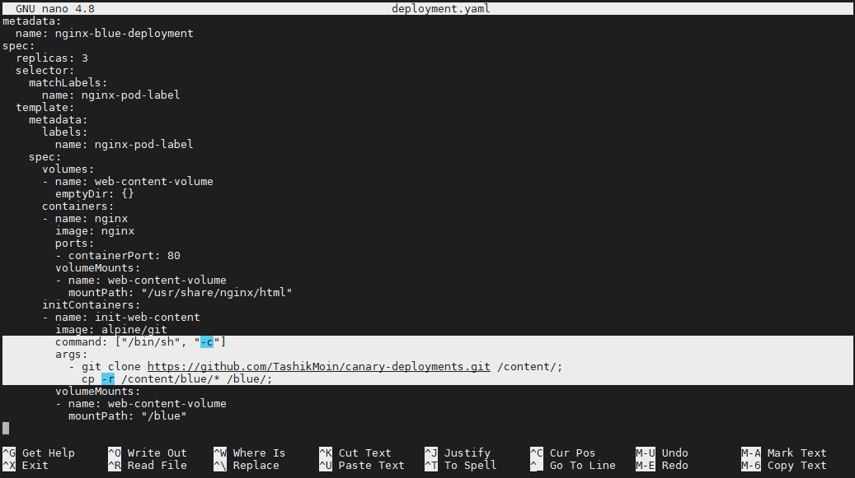
A way to give multiple commands to a container by invoking bash or sh shell as main process and passing args to it. Every command is an argument in this approach. Also, this approach should only be used for base os images like alpine, debian, ubuntu, etc. This method of executing multiple commands should not be used with application container images like nginx, mysql etc otherwise the main process will become bash/sh.

Slide 78
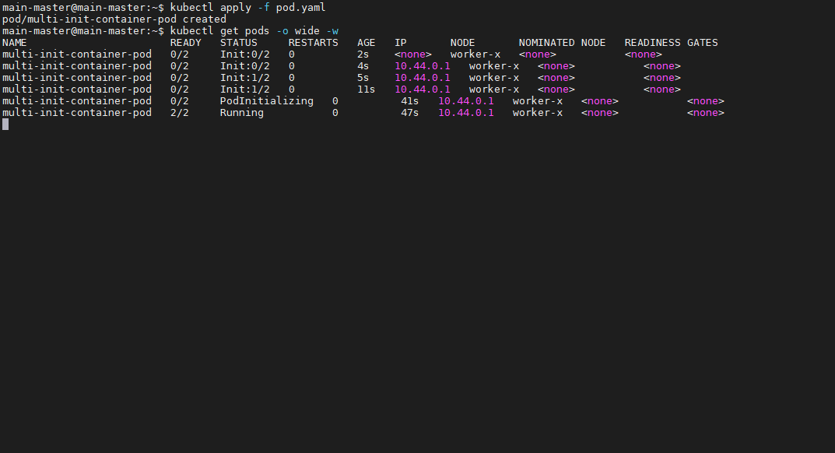
Initializing first init container to pull web content
Initializing second init container that will do nothing but sleep for 30 seconds.

Slide 79
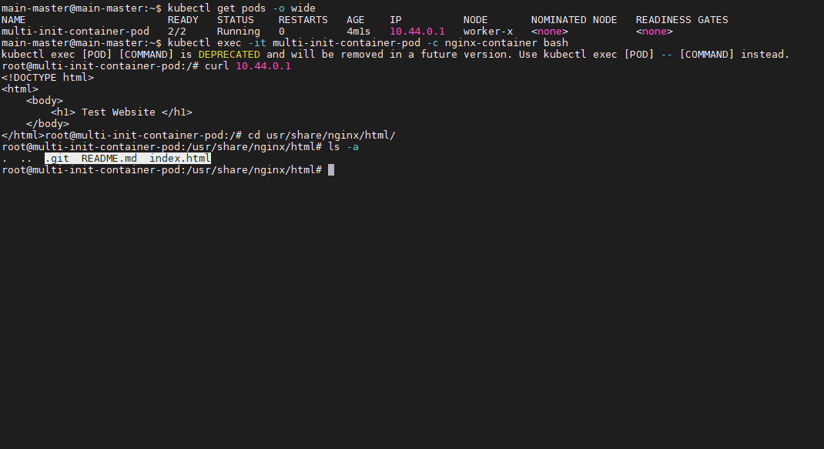

Slide 80
references
https://kubernetes.io/docs/concepts/workloads/pods/
https://kubernetes.io/docs/concepts/workloads/pods/#pods-and-controllers

Slide 81
daemonset

Slide 97
Multinode cluster using kubeadm

Slide 98
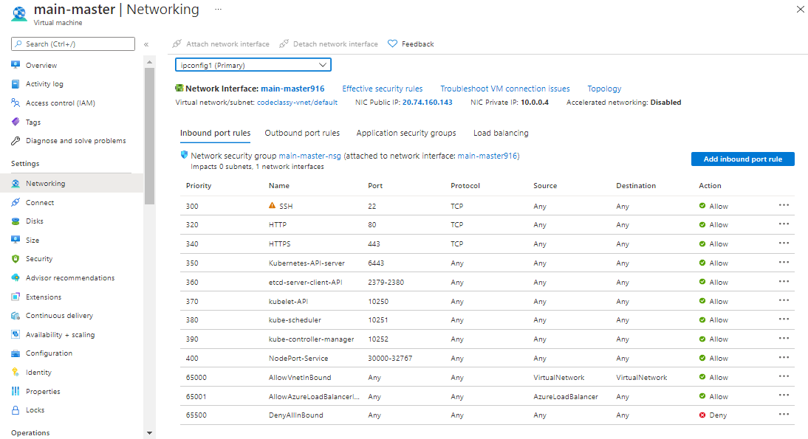

Slide 99
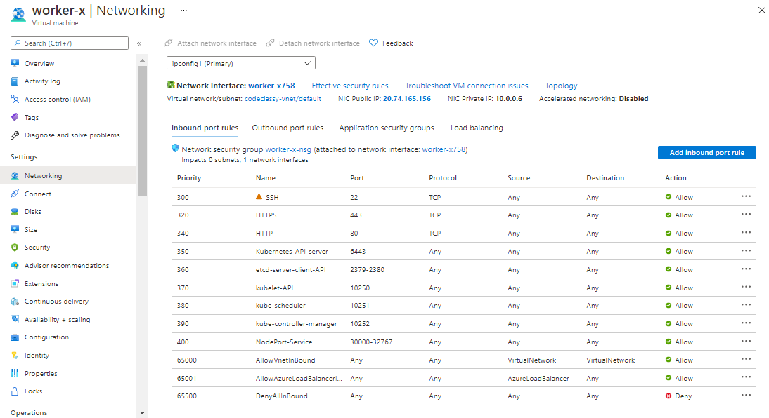

Slide 100


Slide 101


Slide 102


Slide 103


Slide 104


Slide 105


Slide 106


Slide 107


Slide 108


Slide 109


Slide 110


Slide 111


Slide 112


Slide 113


Slide 114


Slide 115


Slide 116


Slide 117


Slide 118


Slide 119


Slide 120


Slide 121


Slide 122


Slide 123


Slide 124


Slide 125


Slide 126


Slide 127


Slide 128


Slide 129

Kubernetes default namespaces

Slide 130

To switch from current namespace to the given namespace.
Pods of default namespace are not visible in development namespace.
To see resources/objects of all the namespaces collectively.

Slide 131


Slide 132

kubectl api-resources | less This command shows what objects/resources can come inside a namespace. For example, “Nodes can not be namesapced”

Slide 133

To delete a namespace.

Slide 134


Slide 135


Slide 136
Simple Yaml file for pods
apiVersion: v1
kind: Pod
metadata:
name: nginx-pod
labels:
type: web-server
spec:
containers:
- name: nginx-container
image: nginx
ports:
- containerPort: 80
kubectl explain --recursive pod | less This explain command can be used to see the entire yaml template/format for any resource/controller/object like pods.

Slide 137


Slide 138
kubectl
Through Kubectl, we communicate with the API server/process of Kubernetes.
Kubectl commands list, https://kubernetes.io/docs/reference/kubectl/overview/

Slide 139


Slide 140


Slide 141

Kubectl cluster-info dump | less

Slide 142


Slide 143

kubectl explain --recursive <any_object/resource e.g pod>| less

Slide 144
Labels
Labels are key value pair identifiers that helps in making groups or to categorize Kubernetes objects. For example, - 3 backend pods - 5 frontend pods - 8 database pods etc. In this example, if we want to assign a group name or an identity to some pods of same family/kind, like 5 pods will have an identify “frontend”, 3 will have an identity “backend” and so on.. This is possible using labels.

Slide 145

selectors
A selectors is also a key value pair or a set of key/ values + operator that helps in picking groups or to categorize Kubernetes objects.
There are two types of selectors, 1. Equality-Based Selectors 2. Set Based Selectors
Equality based selector includes operators like =, ==, != etc. In apiVersion: apps/v1, they are defined under “matchLabels”.
Set based selector includes operators like In, NotIn etc.

Slide 146
Replication controller
Replication controller monitors the pods having labels that matches with the selector of the replication controller and promises to fulfill our desires. It performs create/delete operations to bring the current state back to the desired state.
Replication controller only supports “equality based selector” and it comes under apiVersion “v1”.
Replication controller supports “rolling updates/rolling deployments”, we can update and replace the older version of the application with the newer version of the application.
During rolling updates/rolling deployments, a new replication controller is created and the old replication controller is deleted. In rolling deployment, n pods are deleted from older replication controller and n pods are created at new replication controller and when all the pods are deleted from older replication controller, the older replication controller is deleted and then the traffic is sent to new pods by new replication controller (This causes down time when updating applications to newer versions).

Slide 147


Slide 148


Slide 149


Slide 150


Slide 151


Slide 152

ReplicationControllers comes under apiVersion “v1”.
Labels of RepCon.
Selector is defined under spec of that object/controller/node.
The template field in every controller’s/object’s/node’s is a blueprint of pods that will be controlled/selected by the nodes/controllers/objects.
Q Why we are providing labels in the pod’s template?
A In case if the selector does not find any pod with the given labels under selector or if there is a mismatch between the desired state and the current state, the ReplicationController will create new pods using this template having these given labels and spec.

Slide 153


Slide 154

Even if we create new pods with same labels, the current state then will not match with the desired state because there are more pods than our desires, replicationController will create that new pod but it will then delete another pod from the total to bring the current state back to the desired state.

Slide 155
Replicaset
ReplicaSet also monitors the pods having labels that matches with the selector of the replicaSet controller like replication controller and it also promises to fulfill our desires by performing create/delete operations to bring the current state back to the desired state.
ReplicaSet supports both “equality based selector” as well as “set based selectors” and it comes under apiVersion “apps/v1”.
ReplicaSet does not supports “rolling updates/rolling deployment”, we cannot update and replace the older version of the application with the newer version of the application.

Slide 156


Slide 157


Slide 158


Slide 159


Slide 160


Slide 161


Slide 162


Slide 163

Even if we create new pods with same labels, the current state then will not match with the desired state because there are more pods than our desires, replicaSet will create that new pod but it will then delete another pod from the total to bring the current state back to the desired state.

Slide 164
We can define labels for controllers also so that other controllers can control them. For example, when we create a deployment controller, a replicaSet is created by default, If we want our deployment controller to control multiple replicaSets for different versions of our deployments, then we can do that by assigning labels to our replicaSet under its metadata attribute and we also have to provide selector in deployment controller’s yaml file.

Slide 165


Slide 166
Deployment controller
The deployment controller provides deployment strategies for application deployment

Slide 167
Deployment strategies
Rolling updates.
Recreate.
Canary.

Slide 168


Slide 169


Slide 170


Slide 171


Slide 172


Slide 173


Slide 174


Slide 175


Slide 176


Slide 177


Slide 178


Slide 179


Slide 180


Slide 181


Slide 182


Slide 183


Slide 184


Slide 185


Slide 186


Slide 187


Slide 188


Slide 189


Slide 190


Slide 191


Slide 192


Slide 193


Slide 194


Slide 195


Slide 196


Slide 197


Slide 198



Slide 199


Slide 200


Slide 201


Slide 202


Slide 203


Slide 204


Slide 205


Slide 206


Slide 207


Slide 208


Slide 209



Slide 210


Slide 211


Slide 212


Slide 213


Slide 214


Slide 215


Slide 216


Slide 217


Slide 218


Slide 219


Slide 220


Slide 221


Slide 222


Slide 223


Slide 224


Slide 225


Slide 226


Slide 227


Slide 228


Slide 229


Slide 230


Slide 231


Slide 232


Slide 233


Slide 234
Canary deployments

Slide 236
storage

Slide 237


Slide 238


Slide 239


Slide 240


Slide 241


Slide 242


Slide 243


Slide 244


Slide 245

EmptyDir is a volume that consumes a node’s memory. It is destroyed/erased if a pod dies because it is ephemeral/temporary.

Slide 246

Secret is another volume type that is injected to a node’s tmpfs folder. This tmpfs folder shares secrets to all the pods inside a node. If the last node is killed or destroyed, the tmpfs secret directory is deleted. Each node has its own tmpfs which is not shared with other nodes of a cluster.

Slide 247

Sharing of secrets is not allowed.

Slide 248

ConfigMaps is another type of a K8 volume and it is similar to secrets, the only difference is, they are used to inject configuration files that are required to run an application instead of secrets.

Slide 249
All other volume type references: https://v1-19.docs.kubernetes.io/docs/concepts/storage/volumes/

Slide 250
PersistentVolumes and PersistentVolumeClaims makes it easy to obtain persistent storage without the developer having to deal with the actual storage technology used underneath. But this still requires a cluster administrator to provision the actual storage up front. You think, PersistentVolumes have to been created, but It don't has to be like that all time. Luckily, Kubernetes can also perform this job automatically through dynamic provisioning of PersistentVolumes.
The cluster admin, instead of creating PersistentVolumes, can deploy a PersistentVolume provisioner and define one or more StorageClass objects to let users choose what type of PersistentVolume they want. The users can refer to the StorageClass in their PersistentVolumeClaims and the provisioner will take that into account when provisioning the persistent storage.

Slide 251
Azure disk as backend volume
$ az aks show --resource-group K8-RG --name K8-cluster --query nodeResourceGroup -o tsv Output → _______Node_Resource_Group_Name_______
az disk create \ --resource-group _Node_Resource_Group_Name_From_Previous_Command_\ --name _Azure_Disk_Name_Here_ \ --size-gb _Size_Here_In_GB_ \ --query id --output tsv Output → /subscriptions/<subscriptionID>/resourceGroups/MC_myAKSCluster_myAKSCluster_eastus/providers/Microsoft.Compute/disks/myAKSDisk

Slide 252


Slide 253
apiVersion: v1
kind: Pod
metadata:
name: nginx-pod
spec:
containers:
- image: nginx
name: nginx-container
volumeMounts:
- name: azure
mountPath: /usr/share/nginx/html
volumes:
- name: azure
azureDisk:
kind: Managed
diskName: K8-disk
diskURI: /subscriptions/b6b64038-b80a-48e1-b535-8547feb7bbd1/resourceGroups/MC_K8_k8_uaenorth/providers/Microsoft.Compute/disks/K8-disk

Slide 254


Slide 255


Slide 256


Slide 257


Slide 258


Slide 259


Slide 260


Slide 261


Slide 262
Reference: https://docs.microsoft.com/en-us/azure/aks/azure-disk-volume

Slide 263


Slide 264


Slide 265


Slide 266


Slide 267
https://docs.microsoft.com/en-us/azure/aks/azure-disks-dynamic-pv

Slide 268


Slide 269


Slide 270


Slide 271


Slide 272


Slide 274


Slide 275


Slide 276


Slide 277


Slide 278


Slide 279


Slide 280


Slide 281


Slide 282


Slide 283


Slide 294
StatefulSet
Pods
Pods
Pods
PVC 1GB
PVC 3GB
PVC ’X’GB
PV 1GB
PV 3GB
PV ‘X’GB
StorageClass/LocalDisk/CloudStorage

Slide 295


Slide 296


Slide 297


Slide 298
Pod’s volume is ephemeral which means when a pod dies or is replaced by another pod, its memory is lost. Pod’s memory/volume is shared between all the containers inside the pod.
Container # X
Container # Y
Container # Z
Temporary/Ephemeral Volume
Pod

Slide 299
Namespace
Container # X
Container # Y
Container # Z
Storage Class OR Cloud Storage OR Local Storage
Persistent Volume
Temporary/Ephemeral Volume
Pod
Persistent volumes are placed outside of a namespace in a K8 cluster.
Persistent Volume Claim

Slide 300
K8 Cluster
Namespace
Container # X
Container # Y
Container # Z
Storage Class OR Cloud Storage OR Local Storage
Persistent Volume
Temporary/Ephemeral Volume
Pod
In static provisioning, the Persistent Volumes are created by the cluster administrators “manually”. There can be ‘N’ number of PVs in a cluster, we then create a PVC and the PVC picks the best persistent volume from the available PVs based on its requirements.
Persistent Volume Claim

Slide 302


Slide 303


Slide 327

Describe command is used to define any object/controller/resource in Kubernetes.

Slide 328

Shows all the available nodes/servers in a cluster.
At cloud, we do not have access to the master node. We can only see worker/agent nodes when working with Kubernetes cluster at cloud. We do not have access to the master node because all these critical maintenance tasks for us are managed by the cloud provider, they does not provide direct access (such as with SSH) to the cluster.

Slide 329
Cloud controller manager
The cloud-controller-manager is a Kubernetes control plane component that embeds cloud-specific control logic. The cloud controller manager lets you link your cluster into your cloud provider's API, and separates out the components that interact with that cloud platform from components that only interact with your cluster. The cloud provider’s API manages everything, that is why we do not have any master node, we can run all the Kubernetes commands and can interact with the API of the cloud provider to manage our cluster like a master node does.
By decoupling the interoperability logic between Kubernetes and the underlying cloud infrastructure, the cloud-controller-manager component enables cloud providers to release features at a different pace compared to the main Kubernetes project.
The cloud-controller-manager is structured using a plugin mechanism that allows different cloud providers to integrate their platforms with Kubernetes.

Slide 330

Cloud controller manager

Slide 331
Workload resources
Kubernetes pods have a defined lifecycle. For example, once a pod is running in your cluster then a critical fault on the node where that pod is running means that all the pods on that node fail. Kubernetes treats that level of failure as final. Problem: you would need to create a new Pod to recover, even if the node later becomes healthy.
Solution: However, to make life considerably easier, you don't need to manage each Pod directly. Instead, you can use “workload resources” that manage a set of pods on your behalf. These workload resources configure controllers that make sure the right number of the right kind of pod are running, to match the state or desire you specified. Reference: https://kubernetes.io/docs/concepts/workloads/

Slide 332
Workload resources controllers
Deployments
ReplicaSet
StatefulSets
DaemonSet
Jobs
TTL Controller for Finished Resources
CronJob
ReplicationController

Slide 333

Desire.
Q. The pod is deleted, no new pod was created in place of this pod, Why Kubernetes is not fulfilling my desires? ☹ Resilience promise of K8s?
Ans. This pod was created manually and was not controlled by any workload resource controller, such pods are called “static pods” Note: K8s promises only works when resources are managed by these workload resources controllers.

Slide 334

A new deployment controller to control Nginx deployments.
Initially, only one pod is created in a deployment if no replicas are given.
A new pod is created with a new IP address if we try to delete a pod controlled by any deployment controller, and replicaset controller. The replicaset controller (which is part of a deployment controller) will see our desires given to it at the time of deployment creation and it will try to match the actual state of the cluster with the desired state.
A replicaset controller is also created when we create a deployment controller because a replicaset is a part of a deployment controller that controls the replicas, roll-in, roll-out version updates etc. of a deployment.

Slide 335


Slide 336


Slide 337

Command to scale up/down the pods in a deployment.

Slide 338
There is also an internal service in a Kubernetes cluster that helps in the communication of Kubernetes components. This default service is of ClusterIP type but we have other services too that we will discuss later. Also, a service groups together a number of pods that perform the same function and presents them as a single entity.

Slide 339


Slide 340


Slide 341

We can not decrease the pods count using pod delete command because Kubernetes will create new pods again and again with new IP addresses whenever we try to delete our pods because Kubernetes promises resilience.
We will have to delete the entire deployment controller to delete pod, replicaset or anything associated with the deployment controller.

Slide 342

Just like pods, if we try to delete replicaset or any other Kubernetes resource which is associated with some controller component then Kubernetes will provide resilience for that. However, replicaset itself is a controller object but it is also controlled by another controller object (deployment object) that is why Kubernetes will provide resilience in this case for the replicaset and it will create a new replicaset if we try to delete it. The same concept is applicable for all the resources and controllers (that are controlled by other controllers) in Kubernetes.
Kubernetes has deleted the old replicaset but created a new replicaset with the same name that old replicaset was having. This is because pods are named in the following format, deploymentName-replicaSetId-podId It is taking the old replicaSetId from current pods running in a deployment.

Slide 343

Pods of same deployment “Nginx” scheduled on multiple nodes/servers of same Kubernetes cluster.
Pinging pods of different nodes of the same deployment. This communication was possible because of the “service/Kubernetes”. This service helps in the communication of pods of same deployment and pods of different deployment as well.

Slide 344

Pods of two different deployments “First_Nginx” and “Second_Nginx” scheduled on multiple nodes/servers of same Kubernetes cluster.
Pinging pods of different nodes of the two different deployments. This communication was also possible because of the “service/Kubernetes”. This service helps in the communication of pods of same deployment and pods of different deployment as well.

Slide 345

Accessing the Nginx default page of a pod running on a different deployment controller and a different node.

Slide 346
services
There are 3 types of services in Kubernetes, 1. ClusterIP 2. NodePort 3. Load Balancer
Through services, we do not have to remember the IP addresses of the nodes, pods to access our application, even if a pod dies, Kubernetes will make a new pod with a new IP but we do not have to remember these new IP addresses again and again, we access these pods using a service IP address.

Slide 347
ClusterIp service
It is used for the internal communication of Kubernetes objects/controllers For example, Deployment controller.
It helps in the service discovery of the microservices architecture.
We can not access a clusterIP service outside our cluster.
Use cases, Webserver → Frontend Frontend → Backend Backend → Database etc.

Slide 348
Kubernetes Cluster
Internal Communication Via ClusterIP Service
MySQL ClusterIP Service IP+Port:3306
Web ClusterIP Service IP+Port:8080
Web Deployment Controller
MySQL Pods
MySQL Pods
Web Pods
Web Pods
MySQL Deployment Controller
ReplicaSet Also Balances The Load Between Multiple Pods
ReplicaSet Also Balances The Load Between Multiple Pods
Web ReplicaSet Controller
MySQL Pods
MySQL Pods
Web Pods
Web Pods
MySQL ReplicaSet Controller
Web Pods
Web Pods
Remaining MySQL Pods Inside Node#1
Remaining Web Pods Inside Node#2
Web Pods
Web Pods
Node # 1 (10.102.1.1)
Node # 2 (10.102.2.1)

Slide 349

We use Service IP address to access applications/services but it is converted into any endpoint pod’s IP from the service pool using NAT.

Slide 350

Response with same flow.

Slide 351
NodePort service
It is used for accessing our application through a specific Node. Node_X_IP:NodePort_Service_Port
We can access applications from outside our Kubernetes cluster.
NodePort is not a good for production because opening ports on each node is not an efficient way, it is only used for testing purposes.
When we create a NodePort service, a ClusterIP service is also created to control an object through NodePort.

Slide 352
Internet Requests The Web Service Using Any NodeIP+ServNodePort
Kubernetes Cluster
Similarly, all other nodes of the cluster will expose the same random port of range 30000-32768 with a service port for e.g. NodeIP:34524->8080 and communicate with the web clusterIP service located at node#1
NodePort Service 10.102.1.1:34524/8080
NodePort Service 10.102.1.1:34524/8080
………
Internal Communication Via ClusterIP Service
MySQL ClusterIP Service IP+Port:3306
Web ClusterIP Service IP+Port:8080
Web Deployment Controller
MySQL Pods
MySQL Pods
Web Pods
Web Pods
MySQL Deployment Controller
ReplicaSet Also Balances The Load Between Multiple Pods Of Same + Different Nodes.
ReplicaSet Also Balances The Load Between Multiple Pods Of Same + Different Nodes.
Web ReplicaSet Controller
MySQL Pods
MySQL Pods
Web Pods
Web Pods
MySQL ReplicaSet Controller
Web Pods
Web Pods
Remaining MySQL Pods Inside Node#1
Remaining Web Pods Inside Node#2
Web Pods
Web Pods
Node # 1 (10.102.1.1)
Node # 2 (10.102.2.1)

Slide 353


Slide 354

ClusterIP Service Port

Slide 355


Slide 356

By default Azure Kubernetes Service (AKS) does not assign public IP addresses to the nodes/servers/workers but we can assign them an IP address manually by following few steps mentioned in the documentation to test NodePort service.

Slide 357

Reference: https://docs.microsoft.com/en-us/azure/aks/use-multiple-node-pools#assign-a-public-ip-per-node-for-your-node-pools-preview

Slide 358
Loadbalancer service
We can access applications outside Kubernetes cluster.
Good for production, We can also use ingress controller which works similar to the LoadBalancer.
When we create a LoadBalancer service, NodePort, and ClusterIP services are also created to control an object.
LoadBalancer service is only available at cloud.

Slide 359
Internet Requests
Cloud Load Balancer Service
Similarly, all other nodes of the cluster will expose the same random port of range 30000-32768 with a service port for e.g. NodeIP:34524->8080 and communicate with the web clusterIP service located at node#1
Kubernetes Cluster
NodePort Service 10.102.1.1:34524/8080
NodePort Service 10.102.1.1:34524/8080
………
Internal Communication Via ClusterIP Service
MySQL ClusterIP Service IP+Port:3306
Web ClusterIP Service IP+Port:8080
Web Deployment Controller
MySQL Pods
MySQL Pods
Web Pods
Web Pods
MySQL Deployment Controller
ReplicaSet Also Balances The Load Between Multiple Pods Of Same + Different Nodes.
ReplicaSet Also Balances The Load Between Multiple Pods Of Same + Different Nodes.
Web ReplicaSet Controller
MySQL Pods
MySQL Pods
Web Pods
Web Pods
MySQL ReplicaSet Controller
Web Pods
Web Pods
Remaining MySQL Pods Inside Node#1
Remaining Web Pods Inside Node#2
Web Pods
Web Pods
Node # 1 (10.102.1.1)
Node # 2 (10.102.2.1)

Slide 360


Slide 361


Slide 362


Slide 363


Slide 364
Metal-lb setup for on-premises
kubectl apply –f https://raw.githubusercontent.com/metallb/metallb/v0.10.2/manifests/namespace.yaml
kubectl apply -f https://raw.githubusercontent.com/metallb/metallb/v0.10.2/manifests/metallb.yaml
Kubectl apply –f metal-lb.yaml

Slide 365

Metal-LB services external IP pool range.

Slide 366

Test pod in the same cluster to check deployment load balancer service

Slide 375


Slide 376


Slide 377


Slide 378


Slide 379


Slide 380


Slide 381


Slide 382


Slide 383

- If a pod is satisfying the taints of a node, it is still possible that the pod can be scheduled at other nodes as well who does not even have that taint. - In this case, I created two taints at worker-x node and the pod is only tolerating ½ taints so all the pods will be scheduled at worker-y node because the pod can not tolerate “all” the taints of worker-x node.
- if no effect is given, a pod can tolerate all the effects - if no operator is given, the equal operator will be considered - if only the taint's key is given but the taint's value is not given then the pod will only see the taint's key, if a node has that taint key (with any value) then the pod can tolerate that node.

Slide 384


Slide 385


Slide 386

Possible Effect Values 1. NoSchedule: Do not schedule new/future pods who can not tolerate the node’s taint. If current running pods does not have any toleration for the applied taint, do not stop the current running pods, let them run even if they do not satisfy/tolerate the newly applied taint. 2. PreferNoSchedule: If any pod has satisfied the node’s taint, then that pod “can” be scheduled at that node but that node have less preference than other nodes. There is a high chance that the pod will be scheduled on other nodes because the pod with the taint has less preference.
3. NoExecute: Same as NoSchedule but it also stops/terminates the current running pods from the node.

Slide 387
worker-x does not contain any deployment pod because the deployment pods only satisfied one taint (webserver=true) they did not satisfy (app=true) taint that is why all the deployment pods are scheduled at worker-y node because it has no taint. A pod should tolerate all the taints of a node to get scheduled at that node.

Slide 388

Now, after deleting the previous deployment nodes, a new taint is created at worker-y now the pods of new deployment only satisfies 1/2 taints of worker-x and 0/1 taint of worker-y. Therefore, a pod of this deployment can not tolerate any node because there is no such node whose “all” the taints are satisfied by the pods of this deployment. Hence, they will never get scheduled.

Slide 389


Slide 390

Same command to remove a taint with an additional ‘-’ at the end. ‘-’ indicates the deletion of a taint.

Slide 391


Slide 392

Removing default master node taint to schedule nodes at master node. Since in my case, the master node has only 2 CPU cores and has few resources, Kubernetes is not scheduling pods at my master node because it already has other jobs to do and it is risky to assign more responsibility to the master node. CPU, I/O, and/or memory exhaustion on the master nodes, which would have very severe consequences to the health of the cluster. There is almost never a reason to run any workload on a master node, and almost entirely an increase in risk, so the advice "just don't do it" is well founded.

Slide 399
Haproxy configuration

Slide 400


Slide 401


Slide 402


Slide 403


Slide 404


Slide 405


Slide 407
Helm installation

Slide 408


Slide 411


Slide 412


Slide 413


Slide 414


Slide 415


Slide 416


Slide 417


Slide 418


Slide 419


Slide 420


Slide 421


Slide 422


Slide 423


Slide 424


Slide 425


Slide 426


Slide 427


Slide 428


Slide 429


Slide 430


Slide 431


Slide 432


Slide 433


Slide 434


Slide 435


Slide 436


Slide 440
Jenkins with kubernetes
Install tiller if the helm version is < v3.
Tiller runs on your Kubernetes cluster, listens for commands from helm , and handles the configuration and deployment of software releases on the cluster. Step # 1 kubectl -n kube-system create serviceaccount tiller Step # 2 kubectl create clusterrolebinding tiller --clusterrole cluster-admin --serviceaccount=kube-system:tiller Step # 3 helm init --service-account tiller
Make sure that the tiller pod is running inside the kube-system namespace.

Slide 441

Jenkins with kubernetes (cont)
Add Jenkins updated repository helm repo add Jenkins https://charts.jenkins.io

Slide 442


Slide 443


Slide 444


Slide 445


Slide 446


Slide 447


Slide 448


Slide 449


Slide 450


Slide 451


Slide 452


Slide 453


